Slide 1
Welcome to the June 3, 2026
ISOAG Meeting
Information Security Officer’s
Advisory Group
Notes:
No image title slide - Any text that looks black is HEX code 414042.

Slide 2


Agenda Presenter
Welcome/Opening Remarks | Kendra Burgess / VITA
Evolving Security & Risk Management Modernizing DMV | Beau Hurley / DMV
Pluralsight | Kendra Burgess / VITA
Software Value-Add Reseller (VAR) VA-260316 Contracts | Gregory Brown / VITA
Token Phishing | Scott Brinkley / VITA
Announcements and Upcoming Events | Kendra Burgess / VITA
Adjourn
vita.virginia.gov
Notes:
This slide background works best with text heavy sections, with no imagery OR when an Icon is used

Slide 3

Evolving Security & Risk Management
Modernizing DMV
Beau Hurley, Chief of Risk, Security & Audit
3 June 2026

Slide 4

Why Now?
Multiple Transformations Occurring Simultaneously
Citizen Services
Security Operations
Governance
Virginia Max
Migrating from mainframe to Azure while consolidating service stacks and enabling AI-powered tools for efficiency
Mobile ID
Digital driver license on your
smartphone
DMVnow Update
Biometric identity verification
for secure citizen services
Highway Safety Mobile Learning App
Gamify the Drivers Learning Manual
ARTS
Automated Road Tests
Enhanced Monitoring & Alerting
Continuous monitoring of over 4,500 data shares and access of 186,000 law
enforcement entities
Vulnerability/Exploit Management
Modernized continuous scanning, testing,
and remediation workflows
Joint Operations Center
Unified security, operations, and emergency response
Black Kite MCP Orchestration
Continuous third-party cyber
risk intelligence orchestration
Splunk Cloud Migration (with MCP)
AI Governance Initiative
Formal AI oversight lifecycle
and accountability framework
Enterprise Risk Management
Agency-wide risk visibility
and governance integration on new OnSpring ERM platform (with MCP)
AI Training Internship
Developing AI training for all staff using AI and hosting on Knowbe4

Slide 5
How Security Is Evolving
The Disciplines Remain. The Operating Model Changes
YESTERDAY
TODAY
TOMORROW
Reactive
Proactive
Predictive
Manual Processes
Automated Workflows
Orchestrated Ecosystems
Point-in-Time Reviews
Continuous Monitoring
Continuous Assurance
Human Workflows
AI-Assisted Workflows
Human-Supervised Automation
Siloed Security Teams
Integrated SecOps
Unified Risk Intelligence

Slide 6
Security Operations
Security Discipline Evolution
DMV Example
Today
Impact
Upskill
Benefit
Joint Operations Center
(JOC)
Unified hub for Security,
Operations, Continuity,
Emergency Mgmt, and
Executive Leadership Engagement
Real-time monitoring
across IT, OT, and
citizen-facing services
Monitoring for
law enforcement access
anomalies
Investigation support ( fraud, identity theft, data misuse)
VDEM VEST Officers
Emergency management for weather events, protests, and all other threats
AI expands the attack
surface and the
detection opportunity
Insider threat vectors
require behavioral
analytics (DTEX)
Over 200M log events captured daily
76 operating locations across the Commonwealth
Nearly 100 primary service providers/partners
AI-assisted threat
hunting and triage
Human-supervised
automation for routine
detection tasks
AI-generated Splunk scripts and data analysis
Event analysis using AI to review logs, RSS feeds, external threat intelligence
Faster detection
Reduced manual effort
Mission-aligned response
Increased visibility and operational awareness
All critical systems
under continuous
monitoring/alerting

Slide 7
Identity & Access Management
Security Discipline Evolution
DMV Example
Today
Impact
Upskill
Benefit
Mobile ID
Biometric citizen identity verification integrated into DMV online services
Workforce privileged
account ownership
IAM covers four
identity types:
Workforce
Citizens
Internal Users
External Users
Services
APIs
AI Agents
AI agents require
non-human identities
with governance controls
Zero Trust posture
demands continuous
identity verification
AI agent identity
governance
Non-human identity
lifecycle management
Zero Trust architecture
100% privileged
accounts assigned owners (human
Citizen identity
assurance at scale
API and agent
access controlled

Slide 8
Change Management
Security Discipline Evolution
DMV Example
Today
Impact
Upskill
Benefit
DMV Modernization
Portfolio
Every initiative
passes through security
review before start
Security participates
in project intake
Risk review embedded
in development lifecycle
100% major projects
reviewed pre-launch
Speed of AI-driven
development compresses
review timelines
IT risk rises when security is excluded
Shift-left security integration
AI-assisted code and config review
Agile security review frameworks
Security as a modernization partner
Reduced rework costs
Faster deployment
No surprises at go-live

Slide 9
Risk Management
Security Discipline Evolution
DMV Example
Today
Impact
Upskill
Benefit
Enterprise Risk
Management (ERM) Onspring (MCP)
Risk is continuous, not point-in-time
All risk domains need to be considered, not just IT
Third-party risk grows with vendor ecosystem expansion
AI introduces new risk categories:
Model risk
Data drift
Bias
Explainability
Vendor AI posture must be assessed
AI risk taxonomy development
Continuous risk monitoring practices
ERM integration skills
100% critical vendors
monitored continuously
AI risk integrated into enterprise risk register

Slide 10
Third-Party Risk Management
Security Discipline Evolution
DMV Example
Today
Impact
Upskill
Benefit
Continuous external cyber risk ratings for DMV vendor ecosystem (Blackkite MCP)
Use Agreement audits for data recipients
TPRM is now continuous, not annual
Service bureaus and bulk data recipients under compliance audit program
Vendors using AI introduce new risks:
Data exposure
Model drift
Supply chain compromise
Vendor AI posture assessment skills
Continuous monitoring
platform proficiency
Contract AI risk clauses
100% critical vendors
continuously rated
Compliance audit program for highest-risk data recipients

Slide 11
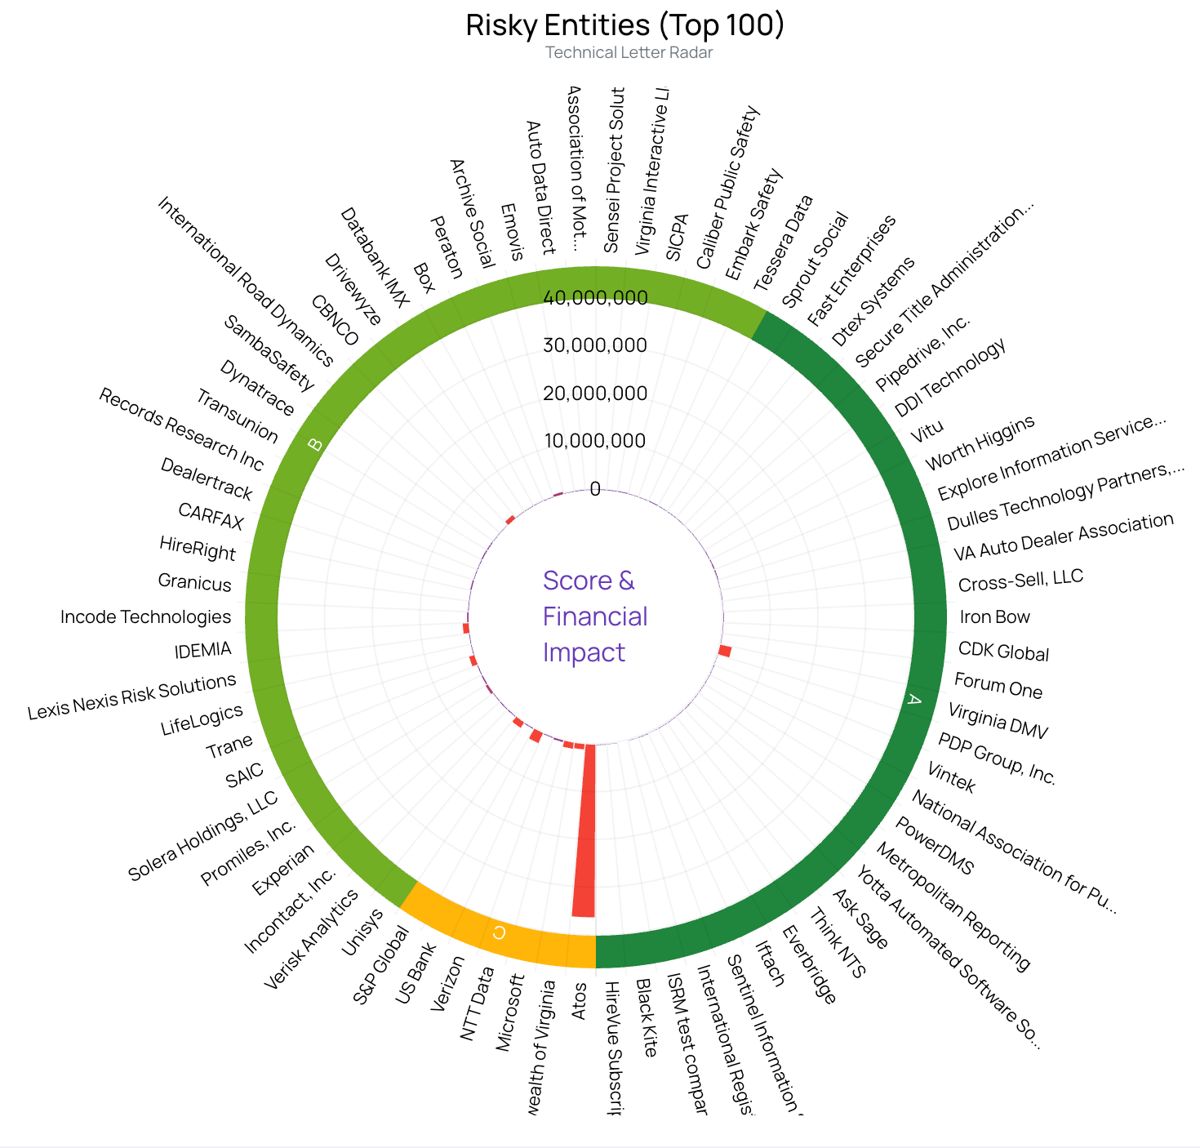
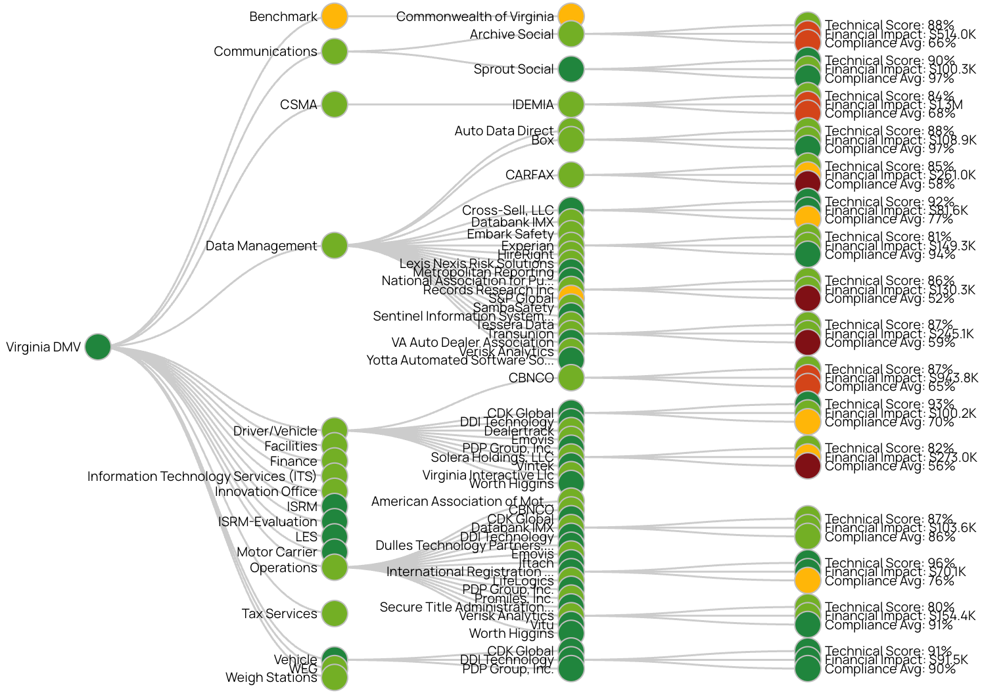
Blackkite OSINT
Find the Signal in the Noise

Slide 12
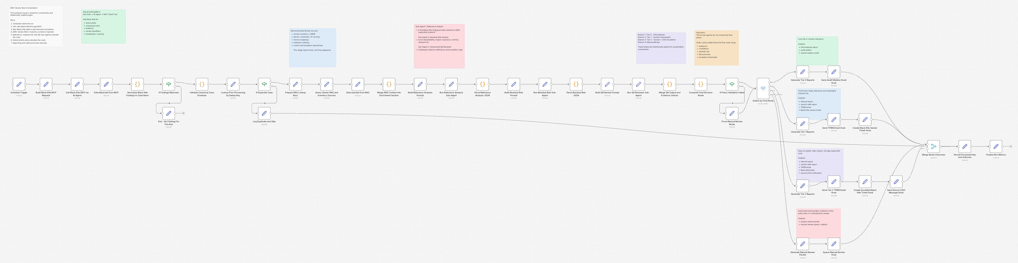
Blackkite N8N Orchestration
RAG based CMDB

Slide 13
Vulnerability/Exploit Management
Know the asset • Know the owner • Know the risk
DMV Example
Today
Impact
Upskill
Benefit
Modernizing the Vulnerability
Management Program
Expanding penetration and application testing
Continuous scanning
replacing periodic
assessments
From periodic scans
to continuous discovery
OSINT and Splunk for vendor insight
Prioritization by
exploitability and
mission impact
AI-generated code
introduces new vulnerabilities if not properly released.
AI replacing script kiddies
Attack surface grows with every new integration
AI-assisted triage
and prioritization
Exploitability-based
remediation scoring
DevSecOps pipeline
integration
Faster remediation
of critical findings
Risk-ranked remediation
queue reduces noise
Mission-critical systems
protected first
Asset intelligence over scanning alone
Continuous visibility into critical assets

Slide 14
Audit
Security Discipline Evolution
DMV Example
Today
Impact
Upskill
Benefit
Use Agreement
Compliance Program
Simultaneous audit
launches across tiered
wave structure
Audit is evolving from
periodic sampling to
continuous assurance
Evidence collection
automated where
possible
AI in workflows creates
new audit scope:
model decisions,
data lineage,
human oversight logs
Continuous assurance
techniques
AI audit methodology
Data analytics for
evidence analysis
100% AI systems
assigned audit owners
Continuous control
testing reduces
point-in-time risk
Continuous assurance over periodic evidence collection
Automation improves visibility
Focus on assurance and outcomes

Slide 15
Resilience
Security Discipline Evolution
DMV Example
Today
Impact
Upskill
Benefit
Joint Operations
Center (JOC)
Mission Essential
Functions identified
and protected
Resilience is
mission-focused, not
just IT recovery
JOC integrates
security, continuity,
and emergency mgmt
AI system failures
require resilience
plans that address:
model unavailability,
data corruption,
decision chain gaps
Mission Essential
Function analysis
AI system continuity
planning
Tabletop exercises
for AI scenarios
100% MEFs identified
Recovery time targets
defined and tested
AI system fallback
procedures documented

Slide 16
Workforce Development
Security Discipline Evolution
DMV Example
Today
Impact
Upskill
Benefit
AI Governance
Initiative
Building AI literacy
and governance skills
across security
and risk teams
Security professionals
need AI fluency, not
just AI awareness
Roles are expanding,
not being replaced
Creating internal AI training plans
Skill gaps in AI
security create audit,
risk, and governance
coverage gaps
Workforce must grow
into new scope
AI security concepts
Prompt engineering
awareness
Model governance
literacy
Risk-based AI
evaluation skills
Security team able
to evaluate, govern,
and audit AI systems
AI literacy embedded
in all security roles

Slide 17
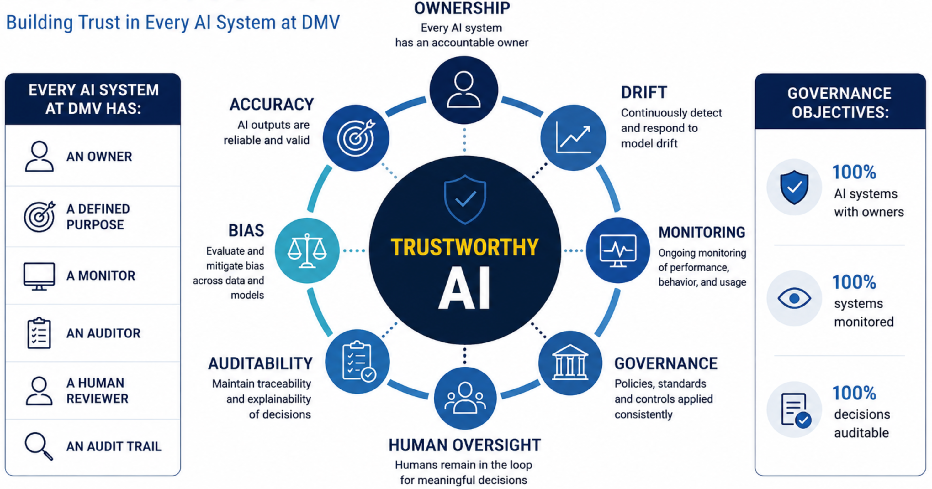
AI Governance

Slide 18
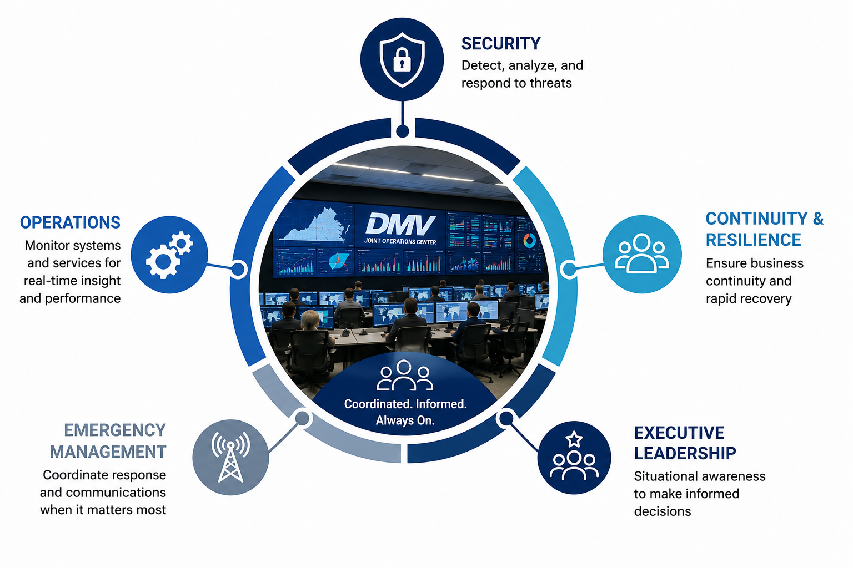
Joint Operations Center
Protect the Mission, Not Just the Technology

Slide 19
The Security Professional of Tomorrow
AI Replaces Tasks. Accountability Remains Human.
LESS TIME ON
MORE TIME ON
Evidence Collection
Manual gathering and organizing audit evidence
Data Gathering
Querying logs, pulling reports, compiling data
Manual Reporting
Building status decks and compliance summaries
Routine Triage
First-pass alert review and ticket routing
Analysis
Interpreting what the data means for the mission
Governance
AI oversight, policy development, accountability
Risk Decisions
Judgment calls that require human accountability
Mission Support
Strategic security advising for agency leadership
->

Slide 20
What We've Learned
Six Lessons from Modernizing Security at Scale
Engage Security Early
Governance Must Scale
Security embedded in intake prevents costly rework and keeps modernization on schedule.
Manual governance cannot keep pace with the speed of AI adoption. Automation is required.
Identity Remains Foundational
Automation Improves Effectiveness
Every new service, API, and AI agent requires an identity with defined access and ownership.
Automating routine tasks frees security professionals for higher-value analysis and decisions.
AI Requires Governance
Mission Focus Matters
AI is not self-governing. Every system needs an owner, a monitor, and an audit trail.
Security decisions must be tied to mission outcomes, not just compliance checkboxes.

Slide 21
The Technologies Will Continue To Evolve.
The Mission Remains The Same.
TRUST
VISIBILITY
Citizens, partners, and leadership trust DMV's systems, data, and services.
Real-time awareness of security posture across all platforms, vendors, and AI systems.
ACCOUNTABILITY
RESILIENCE
Every system has an owner. Every decision has a record. Every risk has a response.
The mission continues through disruption. Systems recover. Citizens are served.

Slide 22
Pluralsight
New platform for Primary ISOs
Kendra Burgess – CSRM Information Security Education and Relations Manager

Slide 23

Pluralsight
Coming Soon: Pluralsight Access for Primary ISOs
  As part of VITA's commitment to the Commonwealth's cybersecurity workforce, Primary ISOs will soon receive access to Pluralsight — a leading technology skills platform with thousands of expert-led courses in cybersecurity, cloud, IT operations, and more.
vita.virginia.gov

Slide 24
Pluralsight Information
What Is Pluralsight? | Why Should ISOs Use It?
Pluralsight offers thousands of expert-led courses in cybersecurity, cloud, software development, data, and IT operations. Key features: Skill Paths: curated learning journeys from beginner to expert. Skill IQ & Role IQ: assessments that benchmark your knowledge and surface gaps. Hands-On Labs: practice in real environments, no local setup needed. Cert Prep Paths: CompTIA, AWS, Azure, and more. | As a Primary ISO, Pluralsight helps you stay current, build expertise, and demonstrate competency in domains critical to your agency's security posture. Benefits for ISOs: Stay ahead of threats: up-to-date security content as the threat landscape evolves. Earn certifications: pursue industry credentials to validate your skills. Learn on your schedule: on-demand access, anytime. Measure progress: Skill IQ shows exactly where to focus. Support your team: share paths and resources with agency IT staff.

Slide 25
Additional pluralsight information
Video Resources | Getting Started
Pluralsight: Accelerate your Tech Career (~2 min) The Future of Work Starts with Pluralsight (~30 sec) Learner Story: How Pluralsight Changed a Career (~2 min) Accelerating Innovation through Tech Skills (~6 min) Feature Clips & Platform Demo (various) Build Technology Skills and Grow Your Career (~1 min) Pluralsight: The Technology Learning Platform (~2 min) Dive Into Pluralsight: The Technology Skills Platform (~3 min)

Slide 26
ISO Meeting
Software Value-Add Reseller (VAR) VA-260316 Contracts
Gregory Brown, Category Manager – Software and Other IT Solutions
Jeanne C. Mertens, Contract Manager – Software VAR

Slide 27
Software VAR Contract Awards
The following seven suppliers have been awarded a Software VAR contract:
  CAS Severn, Inc.; (Small)
  Daly Computers, Inc.
  Optiv Security, Inc.
  ThunderCat Technology, LLC; (Small, Service-Disabled Veteran-Owned)
  Triad Technology Partners, Inc.; (Small, Women-Owned)
  Vertosoft; (Small)
  Vinsys Information Technology, Inc.; (Small/Micro, Minority-Owned)
COTS VA-180917 contracts have been extended until May 31, 2026, for transition.
Software VAR VA-260316 contracts live on VITA’s portal and eVA May 1, 2026.

Slide 28
Software Value-Add Reseller
Scope:
1,300+ publisher/software options, licenses for application software products for specific business functions :
Commercial Off The Shelf (COTS)
Modified Off The Shelf (MOTS)
Software as a Service (SaaS)
Cloud-based or on-premise delivery
Development platforms (Low-code, No-code)
Use by public bodies, but excludes joint efforts across multiple public bodies
Software to support VITA's delivery of enterprise solutions or services
Professional services to include:
Installation, implementation, integration, configuration and training when sold with licenses/subscriptions and provided directly by the software publisher
Maintenance services to include:
Preventive and remedial and intended to ensure continued operation of the software, when sold by the supplier with licenses/subscriptions also sold by the supplier and provided or performed by the software publisher
Managed cybersecurity services:
Specific to contract scope limitations
Value add services include:
Licensing advisory, "right-sizing" utilization services, spend-benefit opportunities and facilitation/repository of third-party publisher agreements

Slide 29
Software Value-Add Reseller
Please note that some software products or publishers may already be available under other VITA statewide contracts, such as contracts for Microsoft, Oracle, IBM or other IT solution-specific offerings. Purchases of those specific products or solutions must go through those contracts.
Out of scope:
Custom-built solutions
Operating systems
Telecommunications software or services
Hardware
Software sold only when embedded via physical or virtual appliance
Major enterprise-wide solutions intended for multi-agency use (such as Cardinal, eVA, etc., determination of in-scope or out-of-scope is in VITA’s sole discretion)
Stand-alone hosting
Infrastructure as a Service (IaaS)
Stand-alone professional or staff augmentation services
Managed services (except for managed cybersecurity services)
Services related to software that was purchased from another supplier/source
Services to support agency change management or agency readiness
Determination of in-scope or out-of-scope is in VITA’s sole discretion

Slide 30
Software Value-Add Reseller
Required for executive branch agencies
This contract is established as the master procurement vehicle enabling access to many software publishers with discounted pricing, but governance of the specific solution is required prior to ordering
A publisher’s name on the price list does not constitute pre-approval for the sale of all products/solutions that the publisher may offer, nor does it constitute pre-approval of Cloud or Artificial Intelligence (AI) or agreement to publisher licensing terms
Agencies must address the following for each solution prior to issuing purchase order (PO):
  Procurement Governance Request
  COV Ramp
  AI
  Accessibility
  Publisher licensing terms
  Statement of Work (SOW) (as applicable) - Required use of VA-260316 SOW template. Limited to $500K publisher-performed implementation/configuration/training (excluding license cost). Sold with licenses.

Slide 31
Software VAR Communications Plan
To inform agencies, localities and VITA staff of the new Software VAR program, the contracts and their options, we have planned for:
VITA website, Supply Chain Management (SCM) – Statewide Contracts, Software VAR Overview and FAQs
Customer Information sessions to learn more about the new contracts:
  Wednesday April 29: 9-10:30 a.m.
  Tuesday May 5: 1-2:30 p.m.
  Tuesday May 19: 1-2:30 p.m.
  Wednesday May 27: 9-10:30 a.m.

Slide 32
Thank you!
Please contact the Software VAR contract or category manager for any additional contract questions.
Jeanne C. Mertens
jeanne.mertens@vita.virginia.gov
Gregory Brown
Gregory.Brown@vita.virginia.gov

Slide 33

June 2026 ISOAG
Token Phishing
Scott Brinkley – Incident Response Manager
June 3, 2026

Slide 34
Token Phishing (ROADTools)
Microsoft Device Token Access
- Microsoft has an ability to register devices for access for a period of time to prevent consistent reauthentication
- Silent, persistent MFA-bypassing access to Exchange, SharePoint, Teams, Azure Key Vault, and Azure resources, conducted exclusively through legitimate Microsoft APIs that produce traffic indistinguishable from normal administrative activity
Remediation
(Block User)
Reset Password
Kill Active Sessions
Remove non-standard MFA
Remove added device from malicious actor

Slide 35
Token Type
Token Type | Purpose | Lifetime | Bound To | Attack Reason
Access Token | Authorizes API calls to a specific resource | 60–90 min | Nothing (bearer token) | Immediate resource access - no re-auth needed for its lifetime
Refresh Token | Obtains new access tokens without re-login; enables FOCI cross-service pivot | Days to Months | App registration | Persistent silent access - regenerates access tokens indefinitely
Primary Refresh Token (PRT) | Device-level SSO token; the Kerberos TGT of the cloud | 14 days (renewable) · ~90 days via virtual device registration | Device + TPM (ideally) | MFA bypass + infinite token factory for ALL Entra-integrated resources; survives OAuth session revocation when obtained via virtual device registration
ESTSAUTH Session Cookie | Persistent browser session cookie granting direct access to Microsoft web services | 14 days | Browser session | Browser-level persistent access - not revoked by Revoke-MgUserSignInSession; separate from token revocation

Slide 36

Example Phish Initial Page

Slide 37
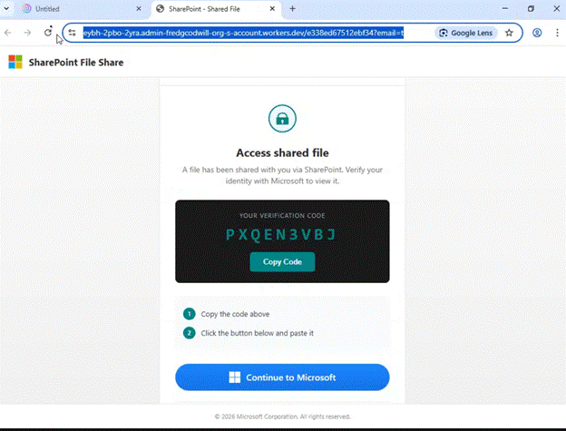
Code Splash Screen

Slide 38

Protection
It is still just a phish at the outset
Don’t click on links or attachments that seem odd even if they come from a COV agency
Long-term fix for Device Tokens in the works. Very hard for shared model agencies.
If a user does click and gets a code splash screen, they should avoid that at all costs. That is the registration of the tokens

Slide 39

Questions
Scott Brinkley
Scott.Brinkley@vita.virginia.gov

Slide 40

Announcements
ISOAG June 2026

Slide 41
Website updates
The Security Products and Services Office hours link
  Can be found on Home | Virginia IT Agency under Security Advisory Groups
  Scroll past Governance Office Hours to find the Join Now link
Document Renames
  Audit Remediation Plan Template Audit Corrective Plan Quarterly
  Initial Corrective Action Plan Template Audit Corrective Plan Initial
Reminder: Always access policy and governance documents directly through vita.virginia.gov — do not rely on saved favorites or old links.​

Slide 42
Opt-out for Centralized ISO Security Services Deadline
ACTION REQUIRED | DEADLINE | 📋 Need Help?
Submit the completed form to Commonwealth Security no later than close of business July 1, 2026. One service only? Complete the section applicable to the service not in use. Neither service? Complete the entire form. More information on centralized services? Contact Commonwealth Security. | July 1, 2026 Close of Business Submit the completed opt-out form by this date. | Unsure of your agency's participation status? Contact CSRM. Questions about completing the form? Contact your CSRM representative — we are happy to help! More information on centralized services? Email Commonwealthsecurity@vita.virginia.gov

Slide 43

Threat Intelligence
• VITA is building out a cyber threat intelligence program. Let us know how the outputs from that program would be most helpful to your agency. Email jared.karnes@vita.virginia.gov
•You may receive threat intelligence advisories about specific vulnerabilities or campaigns that VITA is tracking within agency environments.
•The risks we currently prioritize are vulnerabilities and exploit chains that lead to initial access, data disclosure, and remote code execution (particularly ransomware).
•If you need targeted research and reporting about a specific software exploit, threat actor, etc. we may be able to help.
Notes:
Currently looking for the best place to house and share the advisories that will come out of the cyber threat intelligence program.

Slide 44


Top 5 Vulnerabilities
For the month of June, the Top 5 Key Vulnerabilities are:
Security Update for Microsoft .NET 7 Core (October 2023)
Microsoft ASP.NET (April 2026)
Apache Log4j SEoL (<= 1.x)
Citrix Workspace App for Windows Privilege Escalation (CTX694718)
Adobe Reader < 26.001.21431 Multiple Vulnerabilities (APSB26-44)
*NOTE* Check CSRM Connections for more detailed information
vita.virginia.gov
Notes:
Speaking of website updates, the Top 5 is posted on the CSRM Connections site.

Slide 45
Be a Mentor!
Virginia’s Commonwealth Cyber Initiative (CCI) has partnered with CTE Workforce to launch the Cybersecurity Mentoring Program which connects college students with experienced professionals interested in giving back and creating the next generation of talent.
Share your experience virtually – just 45 minutes per week for six weeks.
No prep required – No curriculum planning or extra workload required—just a conversation.
Make a meaningful impact by guiding future cybersecurity professionals.
All experience levels are welcome – mentors and students are paired accordingly.
If you’re interested in mentoring or know someone in your network who would be a good fit, feel free to reach out or visit cteworkforce.com/cte-teem-program-one.
There are 549 students currently waiting for mentors
vita.virginia.gov

Slide 46
Managing Disabled Accounts in COV AD and M365
Use it or Lose it! (Or you can place it on hold…)
If a COV account is disabled due to inactivity – re-enable the account within 30 days to resync and restore access to user data (mailbox, OneDrive, etc.)
After 30 days: Resources are hard-deleted and cannot be recovered directly.
Recommended steps to avoid data loss:
Ensure regular logins: Users—including contractors—should log into their COV account at least once per month to prevent automatic disabling due to inactivity.
Plan for extended inactivity: If a user will be inactive for an extended period, submit a request using the Temporary Disable COV Account catalog form. This option flags the account to continue syncing with M365 even while disabled.
VITA service catalog update: Feb. 19
vita.virginia.gov
Notes:
Quick reminder—when a COV AD account is disabled, M365 resources like mailbox and OneDrive are soft-deleted and must be restored within 30 days. After that, they’re permanently deleted, so please ensure users log in monthly or submit a temporary disable request to avoid data loss.

Slide 47

Virginia Cyber Security Partnership (VCSP)
Who We Are
The VCSP is a non‑profit collaboration between public and private sector cybersecurity professionals.
Established in 2012 to create a trusted community for discussing cyber threats and sharing best practices.
Our Mission
Strengthen cybersecurity across Virginia through:
Education – K‑12 outreach, collegiate engagement, member workshops
Collaboration – Networking, mentorship, small‑business cyber support
Partnership – Working with law enforcement and supporting cyber policy development
Get Involved
VCSP is seeking volunteers to support mission programs and community initiatives.
Interested? Contact: Amy Braden – Director, IT Security Governance & Compliance (VITA)
Notes:
VCSP held CyberConVA a few weeks ago. This is just a little more

Slide 48

Survey
Attention s'il vous plait
Achtung, bitte
Let op, alstublieft
Athygli vinsamlegast
Oppmerksomhet, vær så snill
Xin chú ý
Atención, por favor
Aire, le do thoil
Or in plain English, give this some attention, please! ☺

Slide 49
Upcoming Events
vita.virginia.gov

Slide 50

Service Tower SOC Report Review Sessions
      To register for this meeting, please click on the link below: https://covaconf.webex.com/weblink/register/rfbee0a945b71936d5d0142c932840b86
The upcoming SOC review session is June 11, 2026, and will be held remotely.
Please register at the link below
Notes:
Example of when to use this slide background for a call out section and text

Slide 51
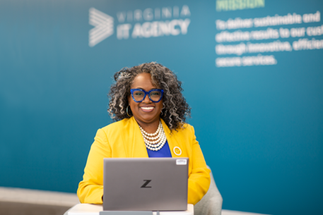
Upcoming Governance Office Hours
Governance Office Hours – a dedicated space for Agency ISOs and teams to bring their questions, concerns, or ideas.
June agenda: Custom Content and BIAs
Next Sessions:
June 18, 2026 | Microsoft Teams
[Click here to register for the meeting]
July 8: [Click here to register for the meeting]
Let’s work together to strengthen governance across the Commonwealth!

Slide 52
Security Products and Service Office hours
Security Products and Services Office Hours – Schedule for June
📅 June 10
Canceled due to RVASec
Sample Agenda
Welcome & Housekeeping
Introductions, recording notice, agenda overview
Program Updates
Latest announcements & milestones
Update from Threat Management Team (1st Session)
Action Item Review
Recap prior items, owners, and status
Open Q&A / Issue Review
Live questions and issue discussion
Follow-ups scheduled as needed
Wrap-Up & Next Steps
Key takeaways and next session preview
📅 June 24th
⏰ 2:00 – 3:00 PM
🔗 Join Link: VITA Connections/Events
vita.virginia.gov

Slide 53

Security Services Fair
June 17, 2026 from 9 am – 11 am
We will be pleased to welcome ISOs and those interested in Security to the Security Services Fair here at the Boulders.
7325 Beaufont Springs Drive, Richmond, VA 23225
Training Room
Registration is required
vita.virginia.gov

Slide 54
Security Products and Services Workshop
July 21, 2026 from noon – 4 pm
Registration is required
vita.virginia.gov

Slide 55

IS Orientation
The next IS Orientation is being held on July 30, 2026
  July 30, from 9am to 4pm, registration closes July 14th.
  It will be held in-person at the Boulders location:
  7325 Beaufont Springs Drive, Richmond, VA 23225
  Visit Commonwealth IS Orientation to register!
Notes:
This slide works best with photos and graphs/charts. Image and text can be reversed

Slide 56
ISOAG is Hybrid!
We do have limited seating for in-person attendance at the upcoming ISOAGs. Please reach out if you are interested in joining us in-person!
It is an excellent opportunity to meet your fellow ISOs and put faces with names. You can also have the opportunity to ask questions in a more informal setting during the break.
** The October ISOAG meeting must still be attended in-person by Primary, In-scope agency ISOs.

Slide 57

COV Information Security Conference
Please join us on Thursday, August 13, 2026
at The Westin: 6631 West Broad Street, Richmond, VA
Register today!
vita.virginia.gov

Slide 58
Information Security Conference 2026
Commonwealth of Virginia
The Quantum Mirror: Reflecting on Security in a Multiverse
Aug. 13
The Westin Richmond
Henrico, VA
Learn more at: vita.virginia.gov/isc

Slide 59
MEETING ADJOURNED
Notes:
Title slide - Any text that looks black is HEX code 414042. If you have an idea for an image, let me know and I can provide you with one.

Slide 60
WELCOME TO THE June 3, 2026 ​
ISOAG MEETING​
Information Security Officer's
Advisory Group
Notes:
Title slide - Any text that looks black is HEX code 414042. If you have an idea for an image, let me know and I can provide you with one.

