Slide 1

WELCOME TO THE May ​
ISOAG MEETING​
Information Security Officer's
Advisory Group
May 14, 2025
Notes:
Title slide - Any text that looks black is HEX code 414042. If you have an idea for an image, let me know and I can provide you with one.

Slide 2

Agenda Presenter
Welcome/Opening Remarks | Kendra Burgess/VITA
Implementing CIS IG2: Tales from the Crypt | Randy Marchany/Virginia Tech
Introduction to Enterprise and Security Architecture | Chris Williams/VITA
Phishing Reporting and Phishing Simulation Update | Matthew Umphlet/VITA
TLS 1.0/1.1 Remediation | John Del Grosso/VITA
Upcoming Events and Announcements | Kendra Burgess/VITA
Adjourn
vita.virginia.gov
Notes:
This slide background works best with text heavy sections, with no imagery OR when an Icon is used

Slide 3
Implementing CIS IG2: Tales from the Crypt
Randy Marchany
Virginia Tech IT Security Office and Lab
marchany@vt.edu
https://security.vt.edu
If we don't write the rules, our adversaries will write our future*.

Slide 4




VIRGINIA TECH BUSINESS PROCESS IT SECURITY MODELS
Academic / Instructional
Administrative
Research
Process that runs the university
Security: CORPORATE
Process that supports teaching/learning
Security: ISP*
Process that supports VT Research
Security: HYBRID
*Internet Service Provider
Challenge: create overall security architecture blending these 3 business process IT security requirements
Notes:
The University has 3 main business processes:
Administrative – these are the business processes that run the University (HR, Purchasing, Registrar, Facilities, etc.). The IT security model for this process closely resembles that of a typical corporation.
Academic/Instructional – the business processes that run and manage classroom instruction. The security model for this process is that of an Internet Service Provider (ISP) because every student brings their own computer, laptop, smartphone, tablet and the University has no controls over what’s installed on those machines.
Research – the business processes that support University research ( grant procurement, grant management, intellectual property. A hybrid of the previous 2 models described here fits Research process security model. Intellectual property requires protection similar to protecting Administrative high risk data. Research equipment, whether homegrown or purchased, has a different set of requirements.
There’s different type of high risk data for each of these processes.

Slide 5
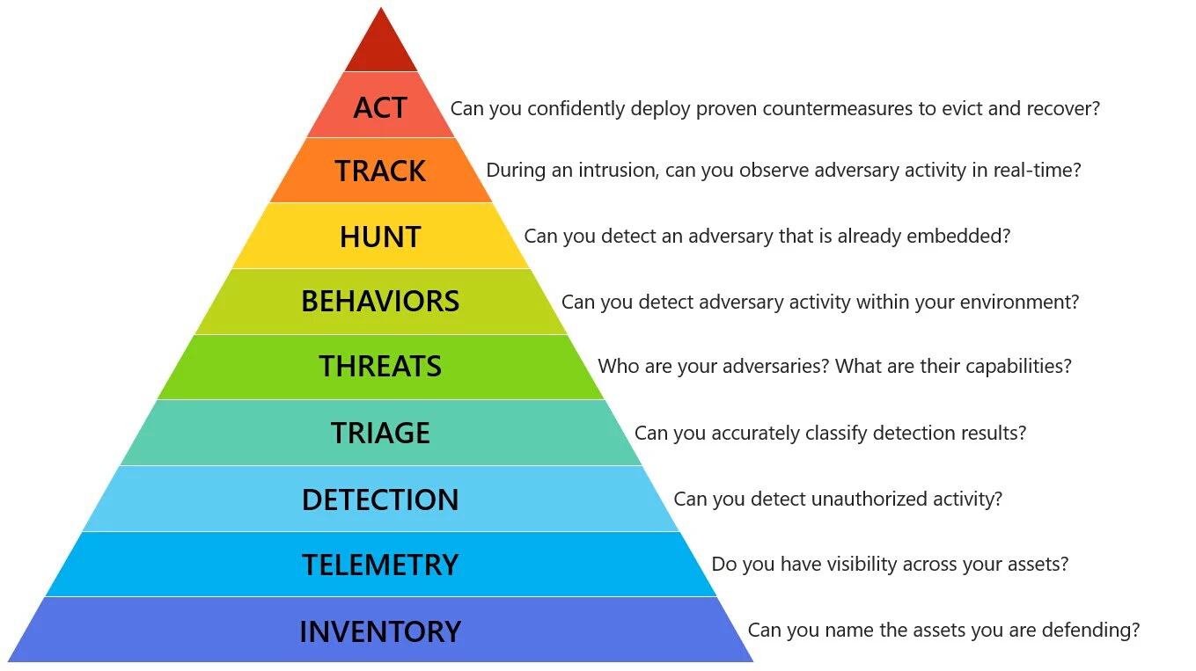
Source: https://holisticinfosec.blogspot.com/2016/12/the-dfir-hierarchy-of-needs-critical.html
Figure source: https://github.com/swannman/ircapabilities
Notes:
Source: https://holisticinfosec.blogspot.com/2016/12/the-dfir-hierarchy-of-needs-critical.html
Figure source: https://github.com/swannman/ircapabilities

Slide 6
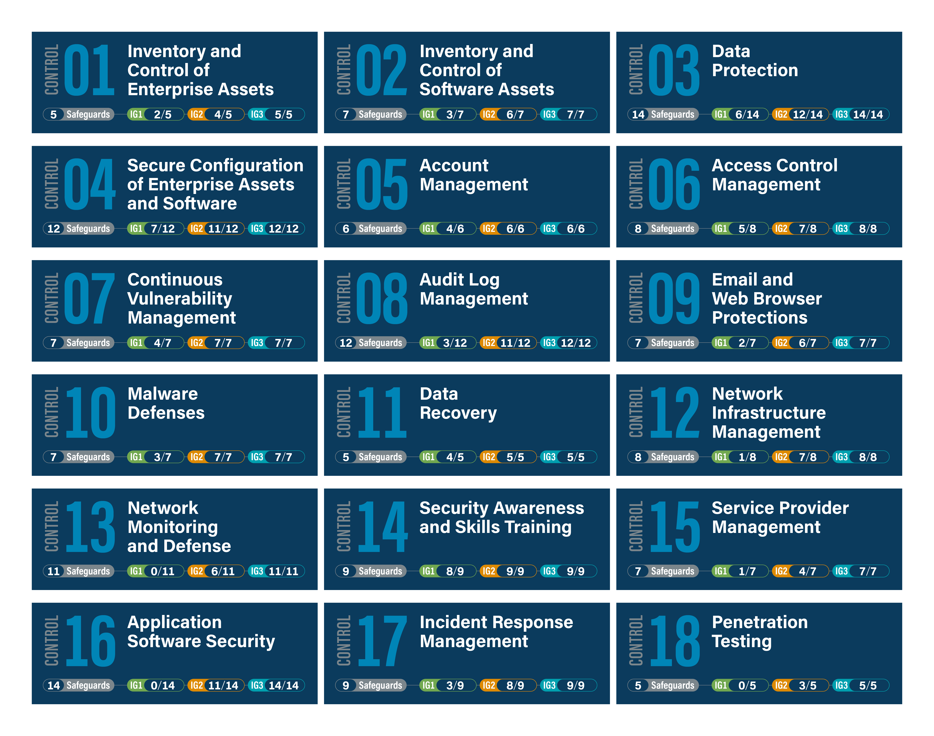

Slide 7
Elevate VT to CIS v8 IG2
Goal:
Compliance with the Center for Internet Security (CIS) Critical Security Controls version 8, Implementation Group 2 (IG2) safeguards for units, systems, and applications that handle, process, or store sensitive (“high” and “moderate” risk) data across Virginia Tech.

Slide 8






Phase I - IT Risk Assessments
Moderate
High
Low
FERPA, PII, Financial, etc
Asset Inventory
Risk Classification
Assessment Survey
Inventory of unit’s hosts and “in-house” developed applications
Determine data handled by assets and classify risk level accordingly
Complete questionnaire(s) based on CIS v8 IG2 controls
Due 6/30/2023
3/1/2025
Due 10/31/2023
6/1/2025

Slide 9
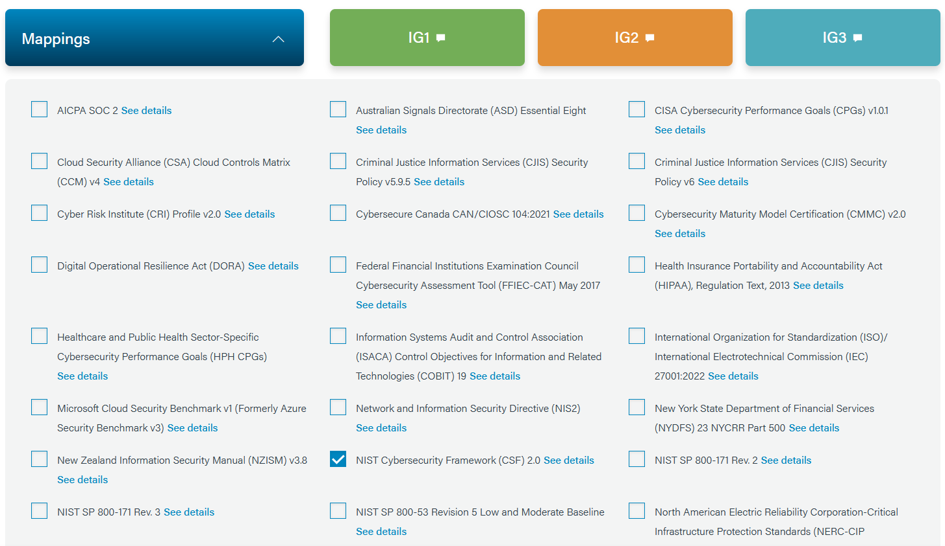

Slide 10
You have the answers already
Inventory isn’t easy
Inventory of authorized and unauthorized devices
  Obtain from your network management team (maybe)
  Who decides what’s unauthorized?
Inventory of authorized and unauthorized software
  Obtain from network infrastructure, software purchasing, fixed assets, local sysadmin, property mgt. teams, etc.
Inventory of Sensitive Data
  Obtain from business team, local IT staff
  Risk classification standard determines data risk level

Slide 11
What Should Be in an Inventory Record?
“Owner name”, hostname, description, location (on/off prem), inventory tag #, serial #, classification (low, mod, high), priority (non-essential, essential), system type (mobile, laptop, desktop, server, etc.), IT contact, user contact, valid users, managed? (Y/N, BigFix, InTune, JamF, osquery), MDE installed?, comments
Tools: CMDB, Tanium, Axionius, GRC (Isora, SN-GRC), etc.
Hardware, Software, Data, users, network, documentation

Slide 12
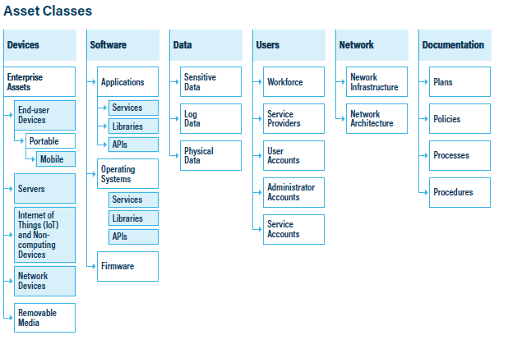
Source: CIS Controls v8.1

Slide 13
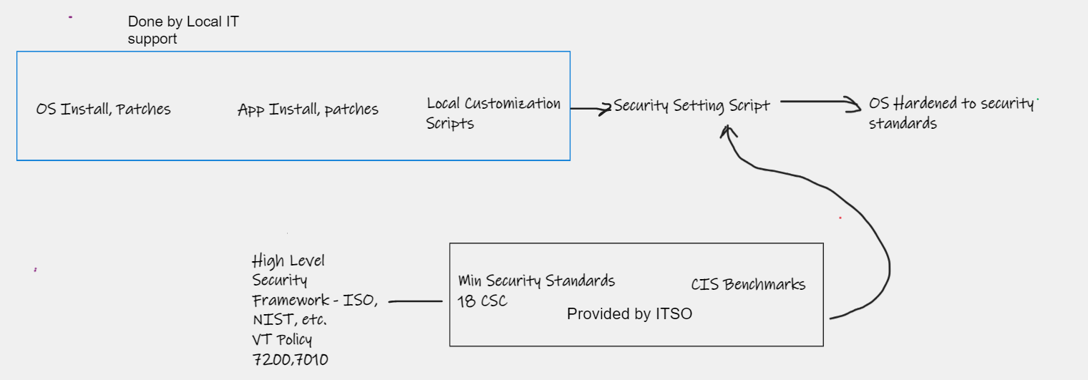
Secure Configuration Roadmap Example

Slide 14
Since 2023
Elevated to Microsoft A5 license
  EDR, Phishing, DLP, robust toolset that runs in Windows, MacOs, Linux, MDE
Requested funding for enterprise wide backup solution
Expanding enterprise wide endpoint management
  InTune, BigFix, Jamf, OSquery

Slide 15
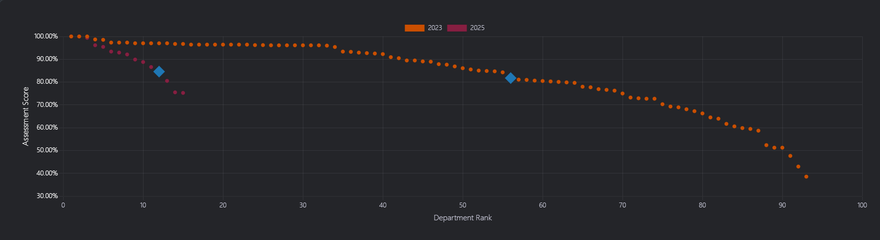
Gap Analysis – Assessment Scores
Incomplete, 2025 assessments due 6/1/25
Lower? More realistic answers, clearer questions….

Slide 16
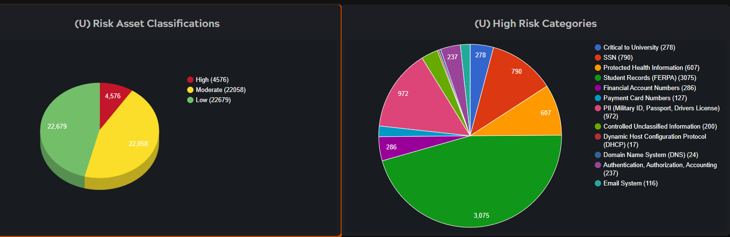
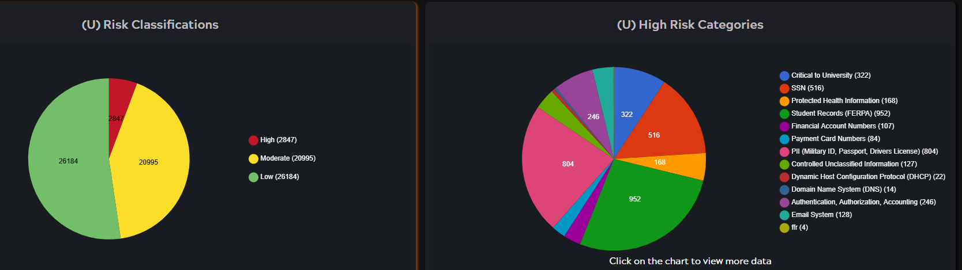
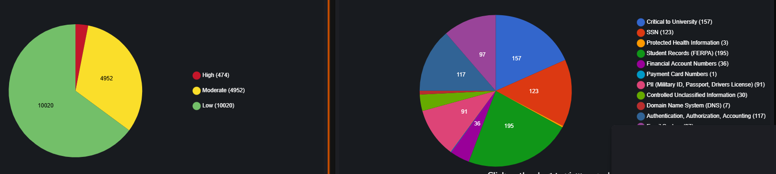
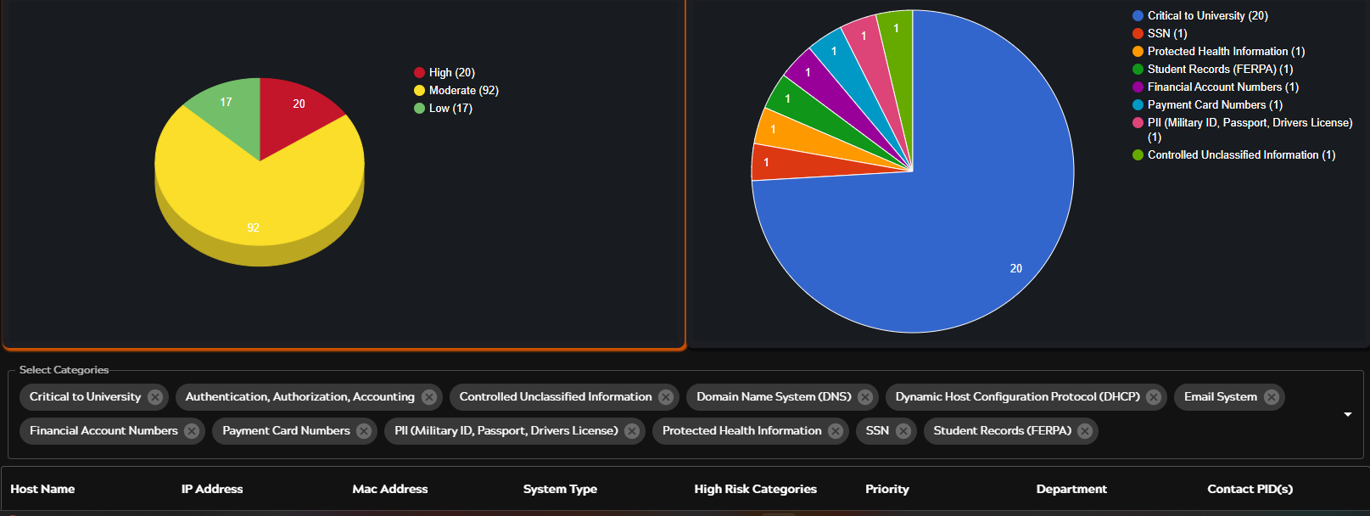

Slide 17
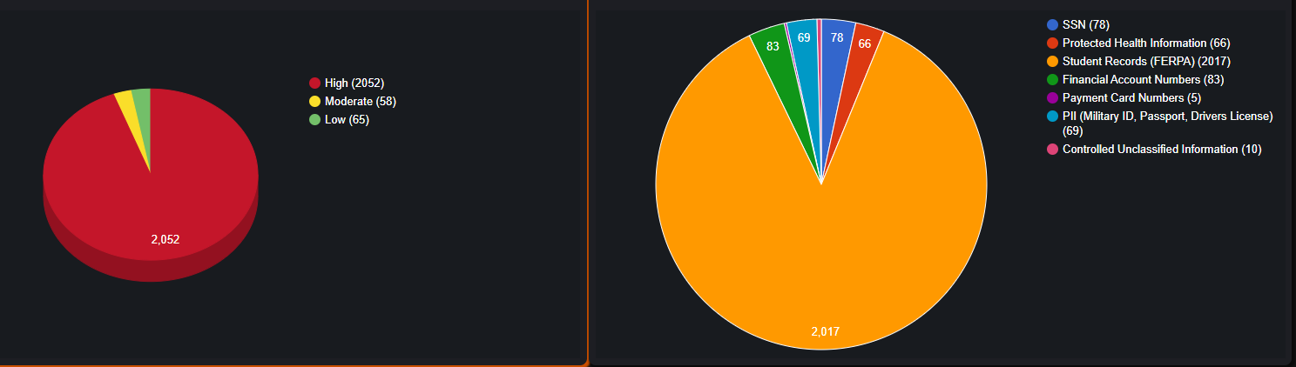
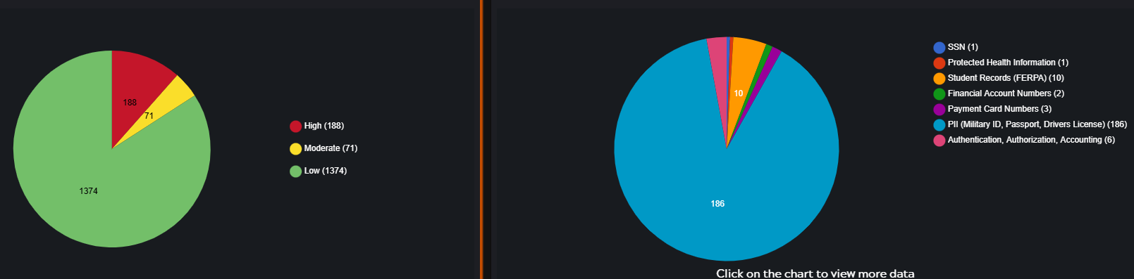

Slide 18
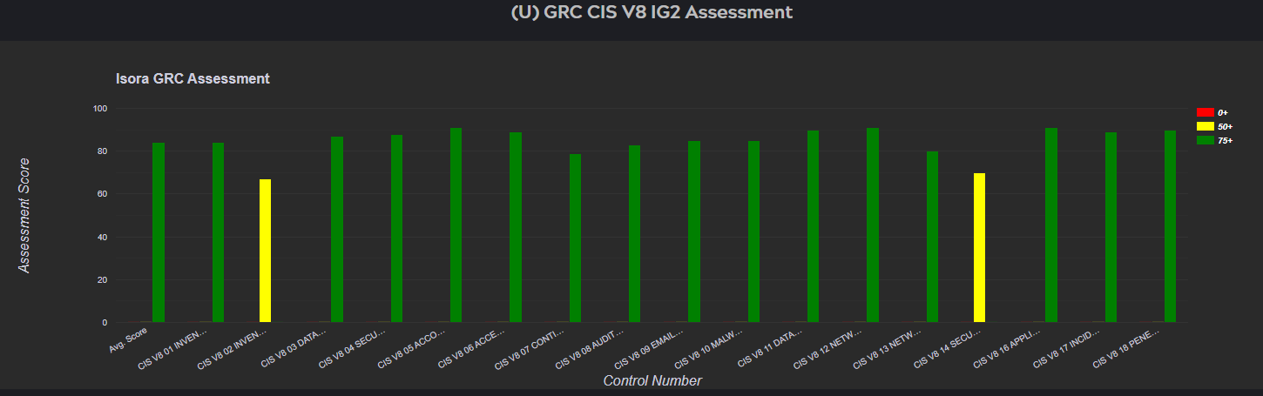
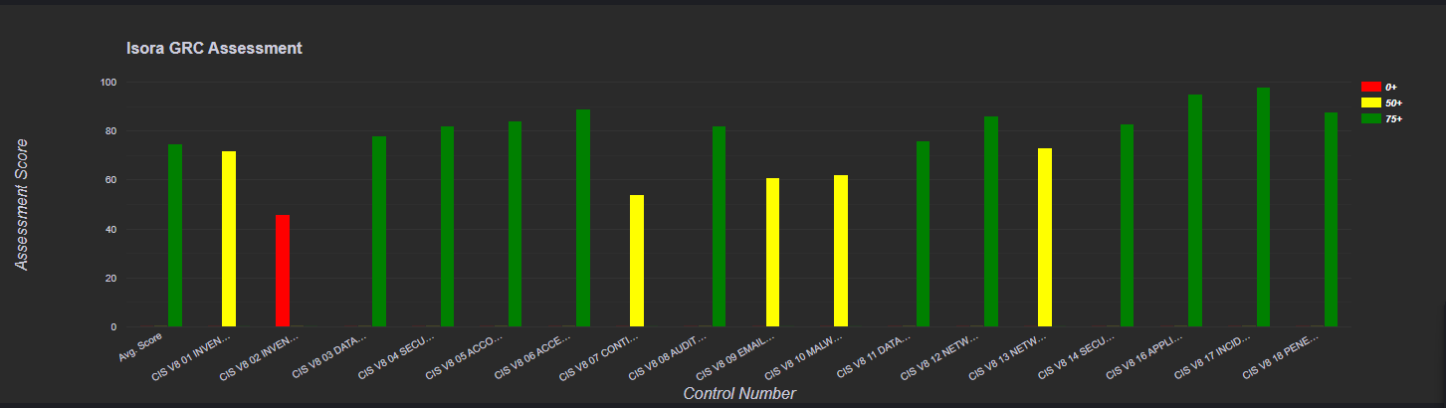
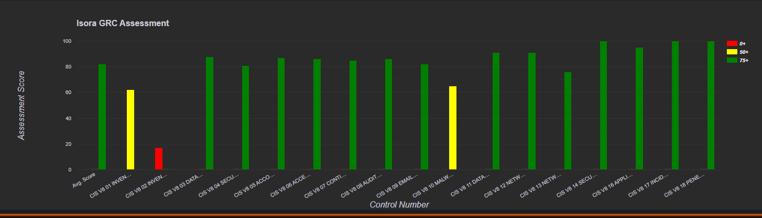
2023 Gap Analysis – the Good, the Bad, the Ugly

Slide 19
Minimum Security Standard (MinSec)
MinSec 4.0 went into effect 7/1/2024.
Not a standard PDF, rather an “active” www page
CIS IG2 has 130 items (“safeguards”) aka “subcontrols”
https://securitystandards.iso.vt.edu

Slide 20
Summary
Go to the CIS CSC V8 Landing Page
  https://www.cisecurity.org/critical-controls
Need an operational plan to implement a Security Framework? Use the CIS Navigator tool
It’s auditable, strengthens your overall defensive posture

Slide 21
References
“If we don't write the rules, our adversaries will write our future.” – Rob T. Lee, SANS Institute
Virginia Tech Minimum Security Standards – https://securitystandards.iso.vt.edu
CIS Controls: https://cisecurity.org/v8
CIS Navigator tool: https://www.cisecurity.org/controls/cis-controls-navigator
Virginia Tech Risk Assessment Standard: https://it.vt.edu/content/dam/it_vt_edu/policies/Virginia-Tech-IT-Risk-Assessment-Standard.pdf
Virginia Tech Policy on Securing Technology Resources and Services: https://www.policies.vt.edu/7010.pdf

Slide 22
IMAGE
Security & Enterprise Architecture
ISOAG
Chris Williams, Director of SA/EA
May 14th, 2025

Slide 23
Agenda
Introduction from “new” EA/SA Director
Who SA/EA is
SA
EA
Engaging EA
Examples of FOIA Requests
vita.virginia.gov

Slide 24
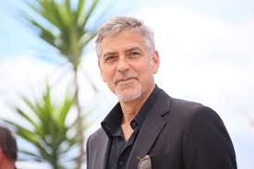
CISO: CHIEF INFORMATION SECURITY OFFICER, MICHAEL WATSON
“New” Director of Security & Enterprise Architecture
Started role in Feb 2025
Commonwealth Experience includes:
  DIT (precursor to VITA) in 1999
    Managed internal IT
  VITA
    Cloud Architect
    Cloud Services Manager
  DSS
    Cloud Infrastructure Operations Director
Other EA Experience includes:
  Led EA Governance team at Capital One
  EA with Federal Reserve/TWAI
Additional IT roles with TEK Systems, Cognizant, Anthem, Markel in variety of Service Delivery roles
Examples of FOIA Requests
Chris Williams (no really, that is me)
vita.virginia.gov
Notes:
This slide background works best with text heavy sections, with no imagery is used OR when an Icon is used

Slide 25
SA & EA – Who we are
Chris Williams – Dir of SA & EA
Chandos Carrow – Manager SA
Stephen Smith – Manager EA
Jacqueline Esters
Preston Talbot
Jr. SA Architect
SSP Team
Robert Kowalke
Karen Baldwin
George Smigelski
Mario Epps
Harita Cheruvu
Alex Nygren
Vera Agamah
Sean Weir
Manasa Lagisetty
Jelica Calderon
Examples of FOIA Requests
vita.virginia.gov

Slide 26
SA & EA - What does SA Cover?
SEC530 – Information Security Standard
Security Exceptions
SSP’s – System Security Plans
  Writing SSPs, process is owned by CSRM Governance & Compliance
Baseline review
Solution Support
  RFS Guidance
  Enterprise Procurement

Slide 27
SA & EA - What does EA cover?
EA 200 – Enterprise Architecture Policy
EA 225 – Enterprise Architecture Standard
  Individual EA standards
EA Exceptions
Enterprise Procurement Support
AI
  AI Registry
  AI CoP (next meeting June 4th)
Technology Roadmaps
  Server OS/Hypervisor example
EA “Tickets”
  DNS
  PGR
  Etc.
Ardoq
  Enterprise Application Information
EA Agency Assistance

Slide 28

Standards Map
28
SEC-530
EA-225 Enterprise Architecture Standard
Storage
Continuity of Services
Identity & Access Management
Event Log Management
End User Compute (EUC) Management
Collaboration
Artificial Intelligence
Internet of Things (IoT)
Business Intelligence Reporting
Web Systems
Networking
Examples of FOIA Requests
Enterprise Technology Architecture (ETA)
Enterprise Solution Architecture (ESA)
Enterprise Information Architecture (EIA)
Enterprise Business Architecture (EBA)
vita.virginia.gov

Slide 29
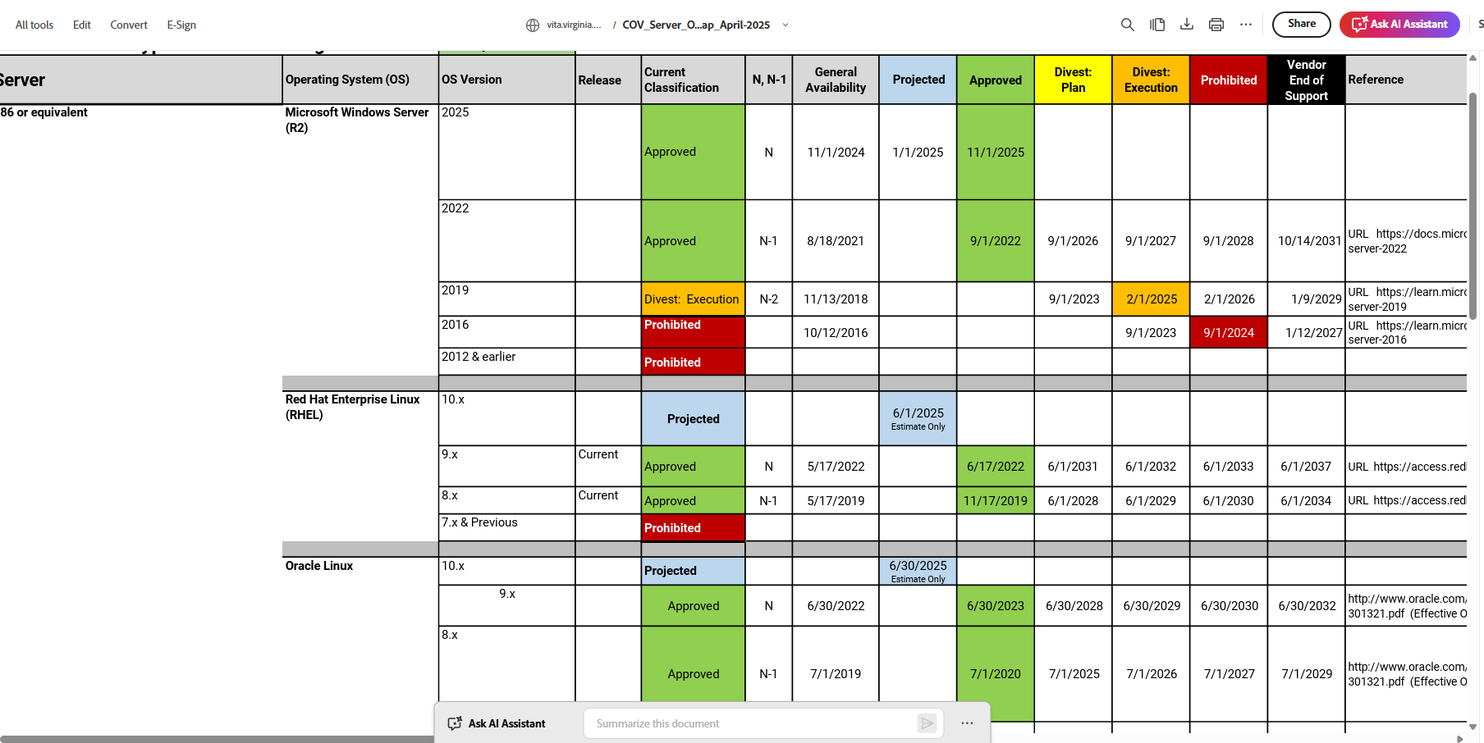
Tech Roadmap
29
Examples of FOIA Requests
vita.virginia.gov

Slide 30
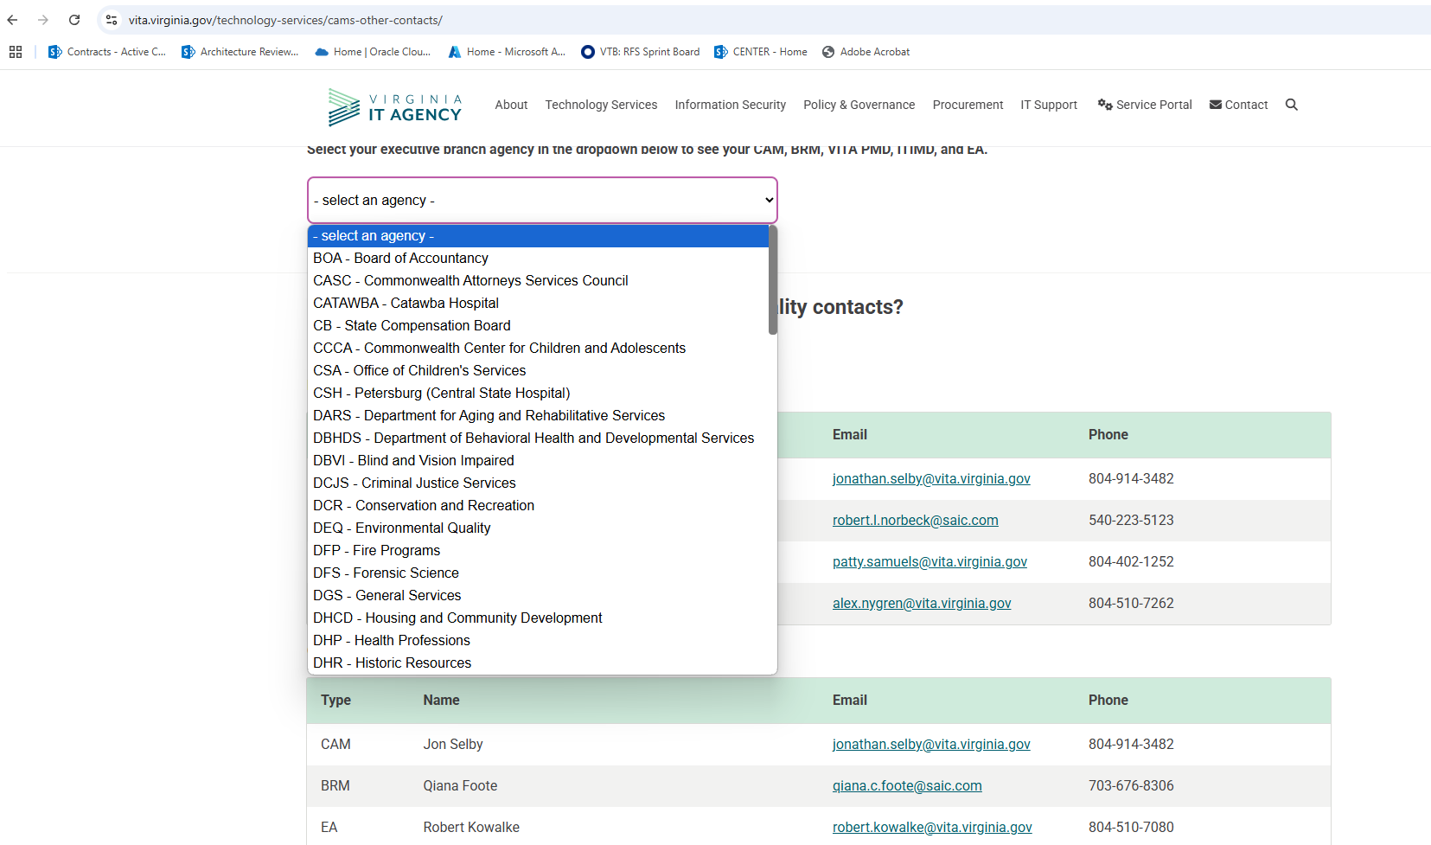
Assigned EA Resource
30
https://www.vita.virginia.gov/technology-services/cams-other-contacts/
Examples of FOIA Requests
vita.virginia.gov

Slide 31
Reaching out to EA:
  Initial step is to reach out to you CAM and/or BRM
    We want to ensure they are aware of anything impacting your agency
  Reach out to the assigned EA resource (per previous slide)
  Send an email to: ea@vita.virginia.gov
  https://www.vita.virginia.gov/policy--governance/enterprise-architecture/
vita.virginia.gov

Slide 32
Questions?
Thank you!

Slide 33
Phishing Reporting and Phishing Simulation Update
Matthew Umphlet, Threat Intelligence Analyst

Slide 34
KnowBe4 PAB and Phishing Simulation Discontinuation
Change in the way that the KnowBe4 PAB is Authenticated in User Mailboxes
On 5/1/25 Microsoft pushed a change that broke the current PAB implementation and requires an unsupported update in the COV M365 environment
KnowBe4 PAB and Phishing Simulations will be discontinued effective immediately
Annual Security Training is NOT affected at this time by this discontinuation and will be continued to be delivered in KnowBe4
VITA CSRM is exploring replacement options, but has selected Microsoft as the Interim Solution Provider

Slide 35
Microsoft 365: Built in Report Phishing Button and Phishing Simulation
The Microsoft 365 Reproting Button allows end users to report Phishing and Spam across Workstations and Mobile Devices
Supported on Web Client and Desktop Client
All Reports will be analyzed by the appropriate VITA Service Tower
Monthly Phishing Simulations will continue to be issued by VITA CSRM
  Agencies are not required to send additional Phishing Simulation

Slide 36
Changes and Limitations
Changes
  Agency ISOs will reach out to VITA to Schedule Agency specific campaigns, up to 6 months at a time
  Agency ISOs will be able to build their own Templates, with enhanced features (New domains, techniques, attachments)
  Agency ISOs will view results from a new dashboard
  Can View and Generate Pass/Fail Reports and Remediation Training Status Reports
Limitations
  Agency ISOs cannot schedule and conduct local phishing campaigns
  Reported Phishing emails cannot be forwarded to agency indicated mailboxes
  Phishing templates cannot be shared before monthly campaigns

Slide 37
TLS 1.0/1.1 Remediation
Enterprise Project
John C Del Grosso
VITA SSDC Service Owner

Slide 38
Overview: Transmission layer security (TLS) compliance
TLS encrypts data that is transmitted over the internet. It is used with websites (https://), remote desktop protocol (RDP), email, etc.
TLS 1.0 and 1.1 are deprecated: These versions have encryption ciphers that can expose systems to attacks such as downgrade attacks and weak cipher exploitation.
Compliance: EA225 requires the Commonwealth of Virginia (COV) to use technologies that are not end-of-life (EOL).
Secure communication: Enforcing modern TLS ensures data confidentiality and integrity during transit, protecting against eavesdropping or tampering.
Discovery: Tenable scans show that TLS1.0/1.1 continue to be allowed on servers (<1,000) in the environment. Port 3389 accounts for majority of these detections.
  Port 3389 is the default transmission control protocol (TCP) port assigned to RDP
  The intent is to force all RDP sessions to use TLSv1.2 only

Slide 39
Activities to block TLS1.0/1.1
Operating system (OS) level restriction
Process
Establishment of security groups for Windows Server 2012, 2016, 2019, 2022 and required OS configuration changes for Linux 6,7,8,9
Restriction: Security group policy restricts the change at the OS Level and does not allow for the use of TLS 1.0/1.1
Reboot required: Changing the setting at OS level requires a reboot to be enacted. Changes will take affect after the scheduled maintenance window reboot for patching.
Status
Testing: Windows testing complete, Linux testing nearly complete
Review of ‘security hardening’ requirements for OS (Windows and Linux) Security hardening restricts TLS 1.0/1.1 in more recent versions of OS (OS2016 and up, Linux 7 and up)

Slide 40
TLS support by operating system
All in-use COV operating systems are hardened do 'disallow' TLSv1.0/1.1 through policy and/or register changes
Windows OS Server | TLSv1.0/1.1 | TLSv1.2 | TLSv1.3
2008R2 | Supported | Supports | Not supported
2012R2 | Supported | Supports | Not supported
2016 | Supported | Supports | Not supported
2019 | Supported | Supports | Not supported
2022 | Supports 1.1 | Supports | Supports
2025 | Supported for clients only | Supports | Supports
Linux OS Server | TLSv1.0/1.1 | TLSv1.2 | TLSv1.3
RHEL 5 | Supported | Not supported | Not supported
RHEL 6 | Supported | Supports | Not supported
RHEL 7 | Supported | Supports | Supported w/updates
RHEL 8 | Supports | Supports | Supports
RHEL 9 | Not enabled | Supports | Supports
RHEL10 | Not enabled | Supports | Supports

Slide 41
Process to change RDP Port to accept TLS1.2/1.3 only
01
02
Agencies will receive an impacted server list from their business relationship manager (BRM)
VITA is identifying server ports using TLSv1.0/v1.1
VITA will set a change date to prohibit TLSv1.0/1.1 on servers with detections for Port 3389 only
VITA will place the server OS in a security group to prohibit TLSv1.0/1.1
03
04

Slide 42
How agencies can help get ahead of the end-of-life deprecation
Work with your application developers to determine if your agency-owned application(s) supports use of TLS v1.2 or v1.3
System administrators should check the operating system (OS) settings. If the OS security settings on a server allow ‘any’ TLSv1.x, switches should be updated to allow TLSv1.2+ only
Agencies should review the server list to be provided by the BRM to identify potential changes or updates
If agency applications cannot support TLS1.2+, then submit security exception(s) in Archer to identify the servers' name, port, agency application(s), and action(s) required.

Slide 43
Next steps
VITA will implement the restriction on servers with TLSv1.0/1.1 detected on Port 3389 only for Windows Servers only - expected quarter three (Q3) 2025.
Look out for VITA communications announcing specific dates for Linux activity.
Agencies should advise their BRM if the change would be an issue for their agency
Further activity will be announced for those servers that show TLSv1.0/1.1 on other ports

Slide 44
Revised Patch Remediation Schedule
The recorded information sessions from March and April are available to watch:
March 19 recording
April 1 recording
The questions from the information sessions and ISOAG were collected and are available for review.
Revised patch cycle frequently asked questions (FAQs) here
vita.virginia.gov
Notes:
This slide background works best with text heavy sections, with no imagery OR when an Icon is used

Slide 45
Questions?

Slide 46

Announcements
ISOAG May 14, 2025
Notes:
Example of when to use this slide background for a call out section and text

Slide 47




Three New Types of User Guides!
There are three new types of user guides available on CSRM Connections:
Hey ISOs! The Archer, Nucleus Acunetix user guides are now published on the CSRM Connections! View the guides today on CSRM Connections (Under the “ISO Resources” link on the right side) Strengthen your agency’s security with ease! 🔐
Learn how to:
✅Access & analyze vulnerabilities
✅Prioritize risks effectively
✅Streamline workflows & boost security
vita.virginia.gov
Notes:
This slide background works best with text heavy sections, with no imagery OR when an Icon is used

Slide 48

International Travel
As traveling season approaches us, lets make sure we all understand how to comply with COV guidelines regarding devices.
Before your trip, be sure to check out the knowledge base article on the VCCC site if you are travelling internationally.
If you’re unsure about any compliance requirements, don’t hesitate to ask!

Slide 49

Action Required: Archer User Access Audit
Who: Information Security Officers (ISOs)
What: Annual audit of Archer user access
When: Due by COB – May 30, 2025
Just a reminder if you received an email last week about the Archer user access audit, make sure it is completed
Important: If not completed by deadline, all Archer access, except ISOs, will be revoked
Issues accessing the link in the email? Contact Kendra Burgess
Questions? Contact CSRM
Notes:
Example of when to use this slide background for a call out section and text

Slide 50
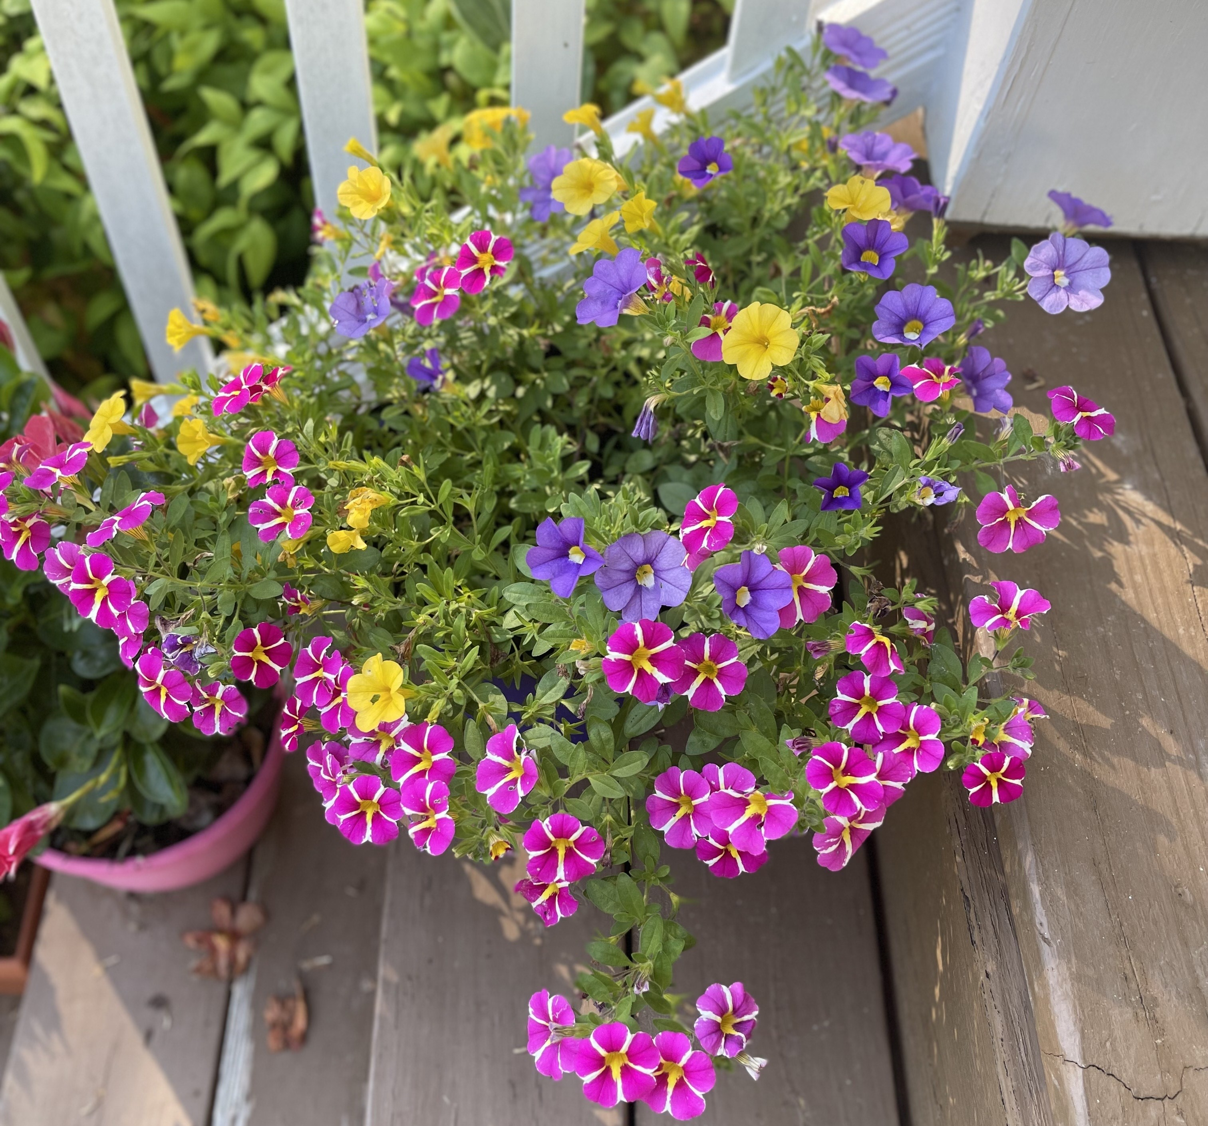
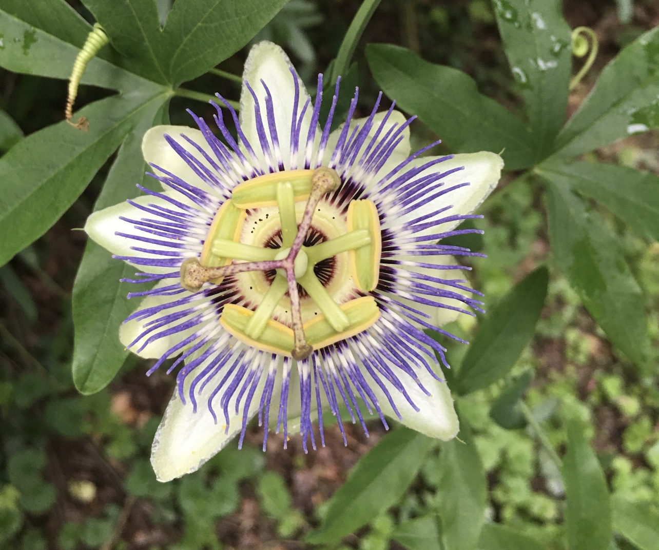
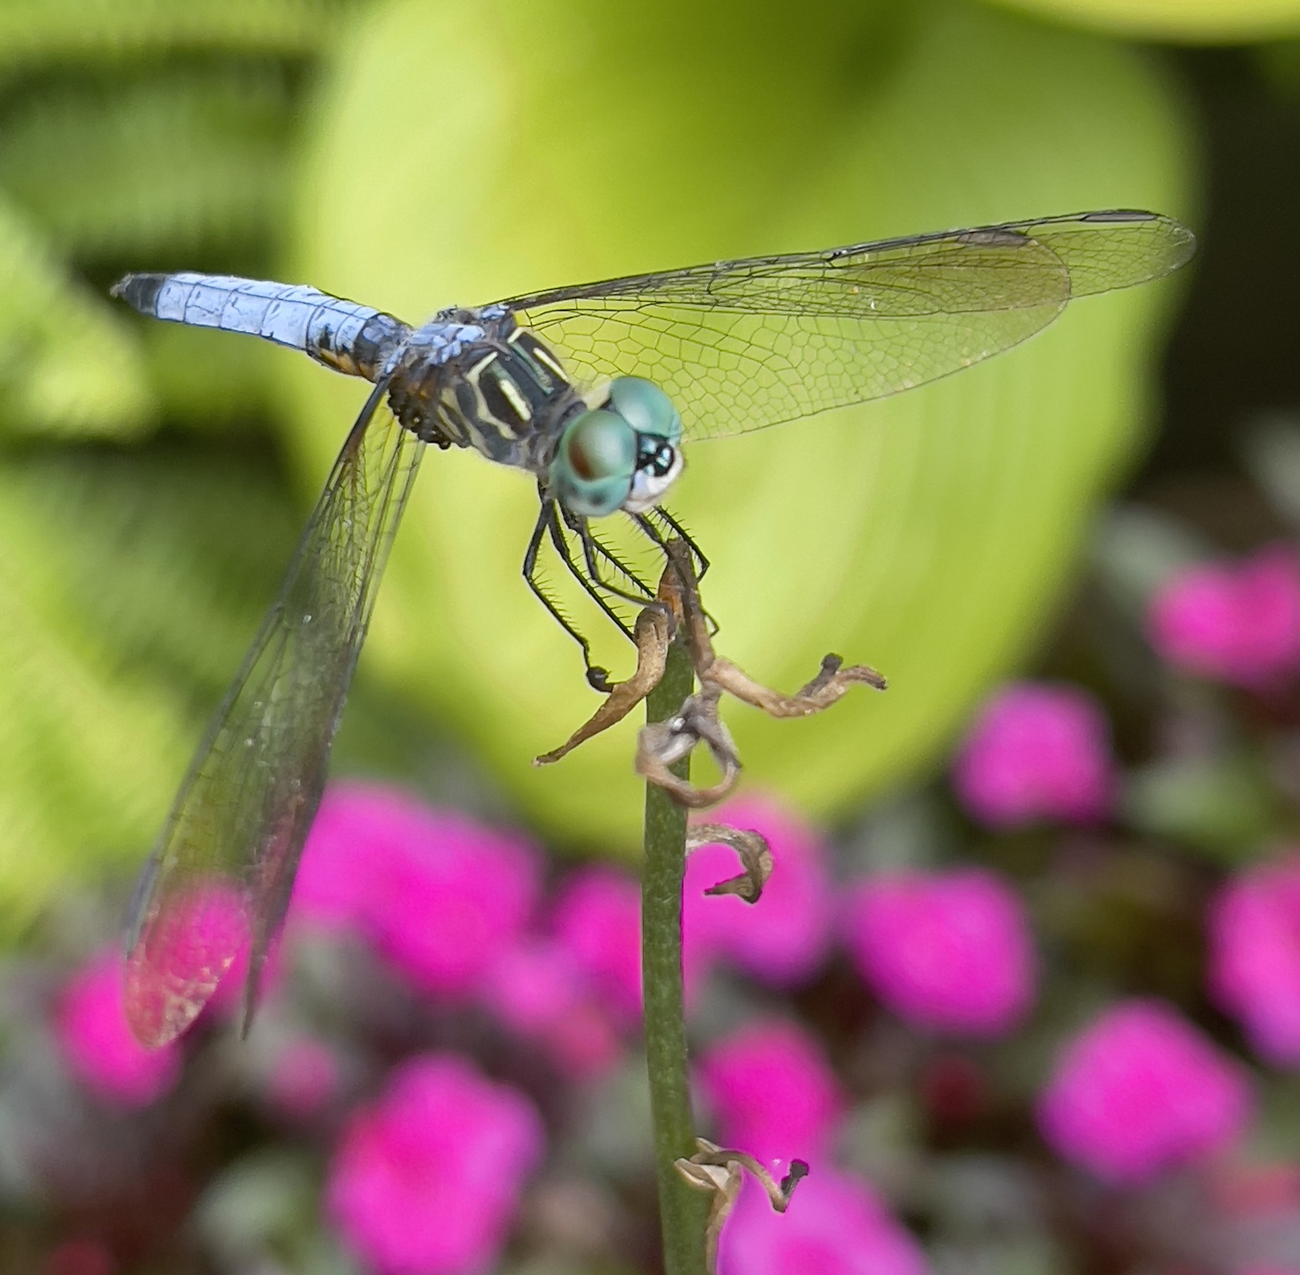
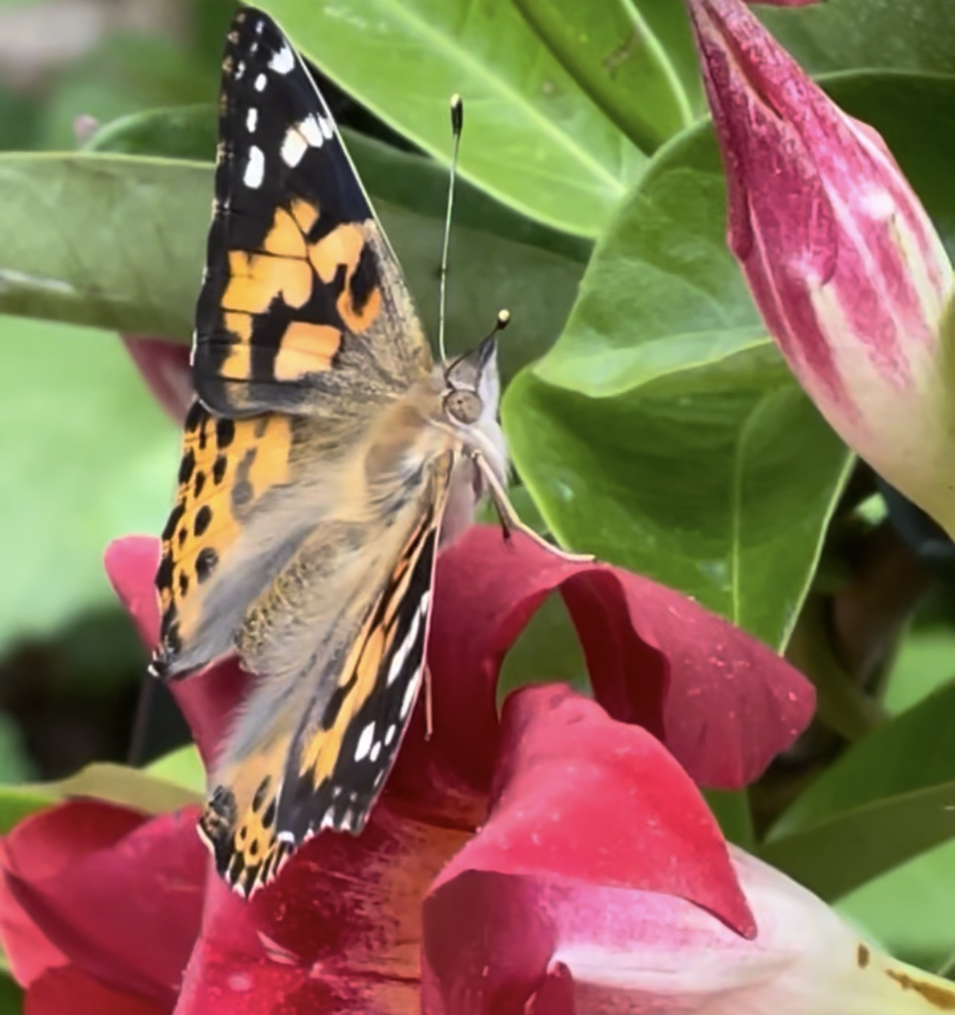
SPLUNK UPDATE – Spring Into Action: Get Your Logs Blooming!
Spring has sprung, so be sure to send in your logs, right into the VITA Splunk instance! Just like pollen in the air (but way less annoying), your logs should be flowing freely. VITA is here to help bring your application logs into Splunk, giving you fresh insights and stronger security. We’re always happy to hop on a call (no bunny suit required) to discuss your options and make sure everything is ready to grow. Let’s make your logs blossom this spring – minus the allergies!
Notes:
Example of when to use this slide background for a call out section and text

Slide 51


Top 5 Vulnerabilities
For the month of May, the Top 5 Key Vulnerabilities are:
  Adobe ColdFusion < 2021.x < 2021u16 / 2023.x < 2023u10 Vulnerability (APSB24-71)
  KB5044293: Windows 10 Version 1607 / Windows Server 2016 Security Update (October 2024)
  Oracle WebLogic Server (October 2024 CPU)
  Tenable Nessus < 10.8.3 Multiple Vulnerabilities (TNS-2024-15 & TNS-2024-16)
  Google Chrome < 130.0.6723.92 Multiple Vulnerabilities
*NOTE* Check CSRM Connections for more detailed information
vita.virginia.gov
Notes:
This slide background works best with text heavy sections, with no imagery OR when an Icon is used

Slide 52
Upcoming Events
vita.virginia.gov
Notes:
This slide is used as a transition title slide for a new section

Slide 53

RVASEC 2025 Security Conference
CISO: CHIEF INFORMATION SECURITY OFFICER, MICHAEL WATSON
The 14th annual RVASEC is coming up.
Breakfast, lunch, coffee & snack breaks
30+ Speakers & keynotes
Capture the flag
Lock picking village and contest.
June 3rd 8am –
June 4th 6pm EDT
Richmond Marriott Downtown
500 E Broad St., Richmond, VA 23233
Registration Link!
Notes:
This slide works best with photos and graphs/charts. Image and text can be reversed

Slide 54

Service Tower SOC Report Review Sessions
      To register for this meeting, please click on the link below:
      https://covaconf.webex.com/weblink/register/r114f684dbdf1015aa82eaa3f39d24e67
The upcoming SOC review session is June 11, 2025, and will be held remotely.
Please register at the link below
Notes:
Example of when to use this slide background for a call out section and text

Slide 55

Governance Office Hours – Now Monthly!
We’re excited to announce the launch of monthly Governance Office Hours – a dedicated space for Agency ISOs and teams to bring their questions, concerns, or ideas directly to the Governance Team.
What to Expect:
Open discussion place
Governance Updates
Q&A and support for your needs
Next Session:
June 18th 2025 | Microsoft Teams
[Click here to join the meeting]
Let’s work together to strengthen governance across the Commonwealth!
Notes:
Example of when to use this slide background for a call out section and text

Slide 56

IS Orientation
CISO: CHIEF INFORMATION SECURITY OFFICER, MICHAEL WATSON
The next IS Orientation is being held on June 25, 2025
  June 25, 2025, from 9am to 4pm, registration closes June 18th.
  It will be held in-person at the Boulders location:
  7325 Beaufont Springs Drive, Richmond, VA 23225
  Visit Commonwealth IS Orientation to register!
Examples of FOIA Requests
Notes:
This slide works best with photos and graphs/charts. Image and text can be reversed

Slide 57

Commonwealth of Virginia Information Security Conference 2025
ISC:25
Future-Proofing Cybersecurity: Next-Gen Strategies
August 14, 2025
Hilton Richmond Hotel
12042 West Broad St.
Richmond, VA 23233
Registration will open soon!
Security Conference | Virginia IT Agency
Notes:
This slide works best with photos and graphs/charts. Image and text can be reversed

Slide 58



COV Information Security Conference 2025
Future-Proofing Cybersecurity: Next-Gen Strategies
Do you know of a potential speaker you’d would like to hear from at the upcoming COV ISC:25? Please let us know at
ISConferenceCFP@virginia.gov

Slide 59
MEETING ADJOURNED
Notes:
Title slide - Any text that looks black is HEX code 414042. If you have an idea for an image, let me know and I can provide you with one.

