Slide 1
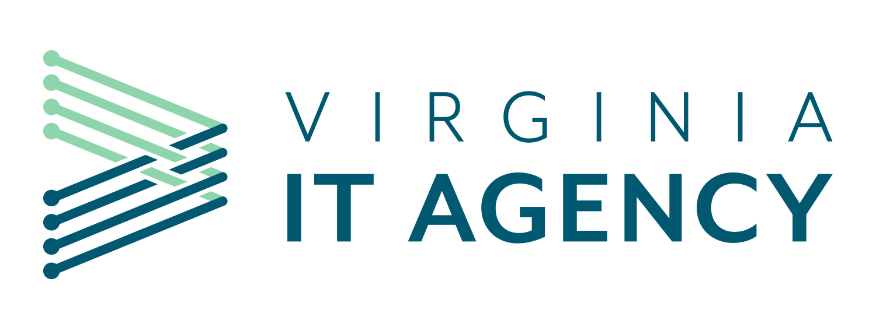
Information Security Officer's
Advisory Group
WELCOME TO THE March​
ISOAG MEETING​
March 5, 2025
Notes:
Title slide - Any text that looks black is HEX code 414042. If you have an idea for an image, let me know and I can provide you with one.

Slide 2

Agenda Presenter
Welcome | Kendra Burgess/VITA
Executive Branch Cyber Liability Discussion | Temo Garcia/AON
Third Party Hosted Cyber Liability Insurance | Jon Smith/VITA
TLS 1.0/1.1 Remediation | John Del Grosso/VITA
Announcements and Upcoming Events | Kendra Burgess/VITA
Adjourn
vita.virginia.gov
Notes:
This slide background works best with text heavy sections, with no imagery OR when an Icon is used

Slide 3

Virginia Treasury
  Executive Branch Cyber Liability
  Discussion
    March 5, 2025

Slide 4

Today’s Meeting
    Current Cyber Placements
      Coverage Overview
    Cyber Market Update
      State of the Market
      Ransomware Update
      Underwriting Evaluation
      Retention / Limit / Pricing Trends
    Analytics and Risk Mitigation
    Claims Overview and Roadmap
This document has been specifically prepared for [Virginia Treasury]. Further distribution and photocopying is not permitted without the express written permission of Aon’s Cyber Solutions Group. The precise coverage afforded is subject to the terms and conditions of the policies as issued. Whether or to what extent a particular loss is covered depends on the specific facts and circumstances of the loss and the terms, conditions and exclusions of the policy as issued.

Slide 5

Coverage Overview

Slide 6

1st Party Coverages

Slide 7
Cyber Insurance
Coverage Descriptions
Breach Event Expenses Triggered by discovery of a privacy or security incident Reimbursement coverage for the insured’s costs to respond to a data privacy or security incident. Policy triggers may vary but typically are based upon discovery of such an event, or a statutory obligation to notify consumers of such an event. Covered expenses can include computer forensics expenses, legal expenses, costs for a public relations firm and related advertising to restore your reputation, consumer notification, and consumer credit monitoring services. | Cyber Extortion Triggered by a threat to cause a security failure or privacy breach Reimbursement coverage for the insured for expenses incurred in the investigation of a threat and any extortion payments made to prevent or resolve the threat. | Digital Asset Protection Triggered by a network security failure, unless system failure coverage provided Reimbursement coverage for the insured for costs incurred to restore, recollect, or recreate intangible, non–physical assets (software or data) that are corrupted, destroyed or deleted due to a network security failure. | Computer Hardware Replacement Triggered by the loss of use of computer hardware/electronic equipment Reimbursement coverage for the insured for the replacement of computer hardware that has been rendered useless due to unauthorized reprogramming/ ransomware. Coverage is sometimes added as its own insuring agreement but is often triggered in conjunction with another insuring agreement, typically network business interruption or data restoration. As such, coverage may only apply if the computer hardware replacement would mitigate business income loss or help restore data/systems
This is a summary and is not intended to be an exhaustive analysis of all coverage items, exclusions, terms or conditions relevant to all claims and exposure situations. Please refer to the actual policy(ies) for coverage items

Slide 8
Cyber Insurance
Coverage Descriptions
Network Business Interruption Triggered by a network security failure, unless system failure coverage Business Interruption – Reimbursement coverage for the insured for actual lost net income, as well as associated extra expense, caused by a computer system outage. Security Failure – Provides coverage for interruption to an insured’s business due to an interruption of an insured’s computer system due to a malicious attack. System Failure – Provides coverage for interruption to an insured’s business due to an interruption of an insured’s computer system due to an unintentional/unplanned outage. Dependent Security Failure – Provides coverage for an interruption to an insured’s business due to the outage of a computer system of a business on which the insured is dependent on caused by a malicious attack. Coverage varies but can include businesses such as information technology providers (cloud providers) or non–information technology providers. Coverage generally only extends to a dependent business where the insured has a contract in place. Dependent System Failure – Provides coverage for an interruption to an insured’s business due to the outage of a computer system of a business on which the insured is dependent on caused by an unintentional/unplanned outage. Coverage varies as described in dependent security failure. Coverage does not typically apply until after the greater of a waiting period or retention. Reimbursement periods vary greatly, but usually reimburse the insured until the restoration of computer systems (up to 120+ days). | Reputational Harm Triggered by an Adverse Media Event during the Policy Period Reimbursement coverage for the insured for actual lost net income as a result of an adverse media report of a network security or privacy incident. Reimbursement period (period of indemnity) varies but often ranges from 30 days to 180 days. A waiting period, usually, from 10 hours to 14 days, may also apply. Coverage may not apply if a computer system outage occurs.
This is a summary and is not intended to be an exhaustive analysis of all coverage items, exclusions, terms or conditions relevant to all claims and exposure situations. Please refer to the actual policy(ies) for coverage items

Slide 9
Cyber Insurance
Coverage Descriptions
Cyber–Crime Triggered by theft of money or resources Reimbursement coverage for the theft of money or resources. Coverage often overlaps significantly with coverage found under a commercial crime policy. Typically only offered at a small sublimit. Cyber–Crime coverage includes social engineering, invoice manipulation, computer fraud, funds transfer fraud, crypto–jacking, and telephone fraud. Coverage names/scope varies and are often intertwined. Social Engineering – Theft of money due to fraudulent instruction by a person purporting to be authorized to make such instruction (i.e. bad actor pretends to be CFO and instructs accounts payable to wire funds). May contain a condition requiring the insured to call–back or further authenticate the transaction. Invoice Manipulation – Theft of money due to the use of a computer system to manipulate payment instructions/invoices so that client/customer payments are redirected to a third party. Computer Fraud–Theft – Theft of money due to the direct or indirect control of an insured‘s computer system. Funds Transfer Fraud – Theft of money due to fraudulent instructions to a financial institution to transfer the insured‘s funds. Crypto–jacking – Theft of an insured‘s resources due to the unauthorized access to/use of an insured‘s computer systems to mine cryptocurrency that results in increased computer hosting costs and/or electricity costs to the insured. Telephone Fraud – Theft of an insured‘s resources due to the unauthorized access to/use of an insured‘s telecom systems that result in increased charges (such as toll call charges).
This is a summary and is not intended to be an exhaustive analysis of all coverage items, exclusions, terms or conditions relevant to all claims and exposure situations. Please refer to the actual policy(ies) for coverage items

Slide 10

3rd Party Coverages

Slide 11
Cyber Insurance
Coverage Descriptions
Network Security Liability Liability coverage for defense costs and damages suffered by others resulting from a failure of computer security, including liability caused by theft or disclosure of confidential information, unauthorized access, unauthorized use, denial of service attack or transmission of a computer virus. | Privacy Liability Liability coverage for defense costs and damages suffered by others for any failure to protect personally identifiable or confidential third–party corporate information, whether due to a failure of network security or not. Coverage may include: unintentional violations of the insured’s privacy policy, actions of rogue employees, and alleged wrongful collection of confidential information. | Regulatory Proceedings Liability Liability coverage for defense costs for proceedings brought by a governmental agency in connection with a failure to protect private information and/or a failure of network security. Includes coverage for fines and penalties to the extent insurable by law. Compensatory damages, i.e. amounts the insured is required by a regulator to deposit into a consumer redress fund, may be covered. | Payment Card Industry Data Security Standards (PCI–DSS) Coverage for a monetary assessment (including a contractual fine or penalty) from a Payment Card Association (e.g., MasterCard, Visa, American Express) or bank processing payment card transactions (i.e., an “Acquiring Bank”) in connection with an Insured’s non–compliance with PCI Data Security Standards. | Media Liability Coverage Liability coverage for defense costs and damages suffered by others for content–based injuries such as libel, slander, defamation, copyright infringement, trademark infringement, or invasion of privacy. The scope of covered media is variable and can range from the insured’s website only to all content in any medium.
This is a summary and is not intended to be an exhaustive analysis of all coverage items, exclusions, terms or conditions relevant to all claims and exposure situations. Please refer to the actual policy(ies) for coverage items

Slide 12

Market Update
Cyber

Slide 13
Cyber Liability
Q1 2025 Market Dynamics
Pricing (Consistent to Slightly Decreasing) | ●
Capacity/Limit (Ample) | ●
Underwriting/Process (Consistent) | ●
Retentions (Consistent) | ●
Coverages (Consistent) | ●
Claims & Loss (Increased Frequency) | ●
Overall | Despite an increase in claims frequency in 2024 and poor loss development on 2023 claims, buyers’ market conditions continued through 2024 for Cyber amidst a well-capitalized and competitive environment. On average, buyers achieved a –6.7% premium decrease in 2024. Reports of abundant and alternative (such as ILS & CAT bonds) capacity led to a favorable 1/1/25 Cyber reinsurance cycle which is a strong indicator buyer friendly markets conditions will continue into the first half 2025 for Cyber insurance purchasers. Insureds are continuing to utilize cyber modeling to evaluate their Cyber purchasing decisions and determine the appropriate limit levels. In 2024, 21% of Aon’s Cyber insurance purchasers added limits to their program.
A Look Ahead | As we kick off 2025, insurers are closely monitoring the loss development that occurred in 2023 and the high frequency potential near systemic type loss events that occurred in 2024 (CrowdStrike, Change Healthcare, CDK, Blue Yonder, etc…). Despite those events, flat to modest rate reductions are expected to remain available as incumbent insurers are highly motivated to retain business, high excess layers on large programs have competition to drive premium down, and new capacity entrants along with high growth goals of legacy Cyber insurers in the middle market segment are driving favorable outcomes for buyers. Risk differentiation will remain key to insurers in 2025. To continue to showcase Insured’s differentiation in the marketplace Aon has established an “Achieving Cyber Resilience Everyday” framework to guide insureds through the process of improving and demonstrating their best-in-class controls to insurers throughout the underwriting process and policy period. Given the stabilizing market conditions Aon brokers are continuing to push insurers to offer differentiated and expanded coverage offerings for evolving risks/threats organizations will face in 2025 and beyond such as: expanded and streamlined business and dependent business interruption coverage, supply chain vulnerability coverage, regulatory coverage inclusive of wrongful data collection events and coverage for Artificial Intelligence creation/usage related events. A continuing trend into 2025 is the potential to secure a long-term agreement (LTA) or a rate guaranteed renewal to drive stability in your Cyber program. As we look forward to what may be an evolving market over the next 3-5 years due to continued decelerating rates combined with increasing claims activity, identifying the right long-term primary and excess insurer partners who understand your risk, have a proven track record of paying claims, and are willing to tailor policy wording to address your risk exposures and incident response strategies is critical.
Exceeds Norms
Meets Norms
Below Norms

Slide 14
Major Market Topics – Cyber
Artificial Intelligence | Cybercriminals are leveraging Artificial Intelligence (AI) and machine learning to automate and scale attacks. Insurers are interested to understand how organizations are using AI to amplify and expand their cyber security defenses. A significant data privacy risk exists if using AI tools and platforms are being used to obtain efficiencies if they are not governed or monitored properly. Many software development AI tools are trained on open–source code – this can be considered an unlicensed use and lead to copyright infringement claims. Insurers are very interested in AI service offerings or the use of AI tools to enhance existing technology or professional service offerings when underwriting those risks for professional indemnity or technology errors and omissions coverage. Adopt an AI Approach with Confidence, for CISOs and CIOs How to Navigate AI-Driven Cyber Risks
Global IT and Supplier Outages | 2024 saw several potential catastrophic cyber events occur. The financial impact on the global cyber insurance market is still unknown, but recent reports and the 1/1/25 cyber re-insurance cycles suggest there will be minimal impact to profitability of cyber insurers. In 2025, we do expect cyber insurers to increase the number of questions asked around the usage of supply chain vendors and cyber security platforms. Top 10 cyber incidents during 2024 revealed | Insurance Business America CrowdStrike Outage: Aon Cyber Solutions Update Lessons Learned from the CrowdStrike Outage: 5 Strategies to Build Cyber Resilience
Privacy Litigation | Insurers are continuing to review policy language and coverage related to wrongful or unlawful collection. Privacy regulatory exposures around the world continue to become restrictive as privacy laws are added or expanded. We are continuing to see an increase in privacy claims related to website tracking, Pixel Tracking and BIPA.
Ransomware | Frequency of Ransomware incidents remains high and the software supply chain continues to be a target for bad actors. Dependent Business Interruption is a significant concern for insurers as large vendor incidents can trigger numerous policies as a result of a single event. Insurers are continuing to grapple with underwriting to systemic events that can lead to aggregation issues.

Slide 15
Cyber Incident Rates Indexed to Q1 2019
Key Observations:
    Ransomware activity was down compared to prior quarters in Q4 2024 yet continued to remain elevated compared to pre-Q1 2023
    Ransomware Events were up 949% from Q1 2019 to Q4 2024
    Compared to Q3 2024:
      Ransomware Events were down by -36%; however, Q3 2024 was one of the largest ransomware quarters to date
      Non–Ransomware Data Breach/Privacy Events were down by -13%
    The most commonly impacted industries by Ransomware in Q4 2024:
      Business Professional Services
      Manufacturing
      Real Estate / Construction
      Healthcare
  Source: Risk Based Security, analysis by Aon. Data as of 1/15/2025; Claim count development may cause these percentages to change over time
  Proprietary & Confidential: The content, analysis and commentary included herein are understood to be the intellectual property of Aon. Further distribution, photocopying or any form of third–party transmission of this document in part or in whole, is not permitted without the express, written permission of Aon.

Slide 16
Ransomware Frequency & Cyber Premium Rates
Year Over Year Change
In Q4 2024, premium rate changes continued to decrease year over year while the Ransomware Frequency was down year over year. However, it’s important to note that Q4 2023 Ransomware was up significantly over Q4 2022.
It’s still unclear how many of these Ransomware incidents are claims with insurance recoveries. (vs. falling within the SIR)
Source: Risk Based Security, analysis by Aon. Data as of 1/15/2025; Claim count development may cause these percentages to change over time
Proprietary & Confidential: The content, analysis and commentary included herein are understood to be the intellectual property of Aon. Further distribution, photocopying or any form of third–party transmission of this document in part or in whole, is not permitted without the express, written permission of Aon.

Slide 17
Aon U.S. E&O-Cyber Broking Reported Incidents by Report Year
Source: Based on Aon U.S. E&O-Cyber Broking clients. Data through 12/31/2024.
Proprietary & Confidential: The content, analysis and commentary included herein are understood to be the intellectual property of Aon. Further distribution, photocopying or any form of third-party transmission of this document in part or in whole, is not permitted without the express, written permission of Aon.

Slide 18
Underwriter Cyber Concerns
Underwriting Considerations
Budget Restrictions: schools and local governments often have outdated technology, facilities, and funding deficiencies. Due to inadequate funding, public entities are often not able to improve cyber security.
Public Space Diversity: the diversity of the public spaces create high record counts, which are common targets for ransomware attacks. Public spaces also have large networks with many EDR’s that create vulnerabilities.
Claims Severity & Frequency Increase: public entities are vulnerable to cyber attacks, market conditions point to increased cyber attacks with public entities being more susceptible.
Business Interruption Costs: claim activity reflects a significant Business Interruption (BI) and Extra Expense exposure for public entities – this has been evidenced through high profile incidents in Atlanta, Baltimore, Pensacola, Oakland, and Greenville. Attacks disrupted operations to court systems, payment systems, police stations, sanitation services, energy departments, etc. BI plays a role in losses as the entities work to bring systems back online. Underwriters pay special attention to RTO’s, disaster recovery plans and backup controls.
Ransomware Exposure: ransomware continues to be the primary driver for claims. The lack of resources and up-to-date equipment make public entities strong targets for ransomware attacks. Gen AI may be playing a role in creating some phishing attacks used to deploy ransomware.
Privacy Exposure: public entities have significant privacy exposure due to the nature and volume of sensitive data they process and store. Underwriters evaluate how this data is stored and what safeguards are in place to store it.
What Underwriters Care About
    Insurance carriers are constantly improving their underwriting processes to better evaluate insureds exposures and controls. To get the best insurance outcomes, insureds need to provide positive responses to underwriter inquiries, either through effective controls or a clear narrative, in all key areas.
Multi-Factor
Authentication (MFA)
Endpoint Detection and Response (EDR)
Phishing Exercise,
Cyber Awareness Training
Patch Management
Secure RDP, VPN
Incident Response Plan, Ransomware Exercice
Access Control, Service Accounts
Disaster Recovery and Backups
Email Filtering
Zero-Day Vulnerabilities and Supply Chain Risks
Network Segmentation and Monitoring
M&A DD and Integration

Slide 19












Cyber Key Controls
Marketplace Minimum Expectations
Multi-Factor Authentication (MFA) | Endpoint Detection and Response (EDR) | Phishing Exercise/ Cyber Awareness Training
Vulnerability Scanning & Patch Management | Secure RDP/VPN | Incident Response Plan/ Ransomware Exercise
Access Control/ Service Accounts | Disaster Recovery/Backups | Email Filtering & Security (DMARC / DKIM)
Zero Day Vulnerabilities and Supply Chain Risks | Network Segmentation/ Network Monitoring | M&A Due Diligence and Integration

Slide 20
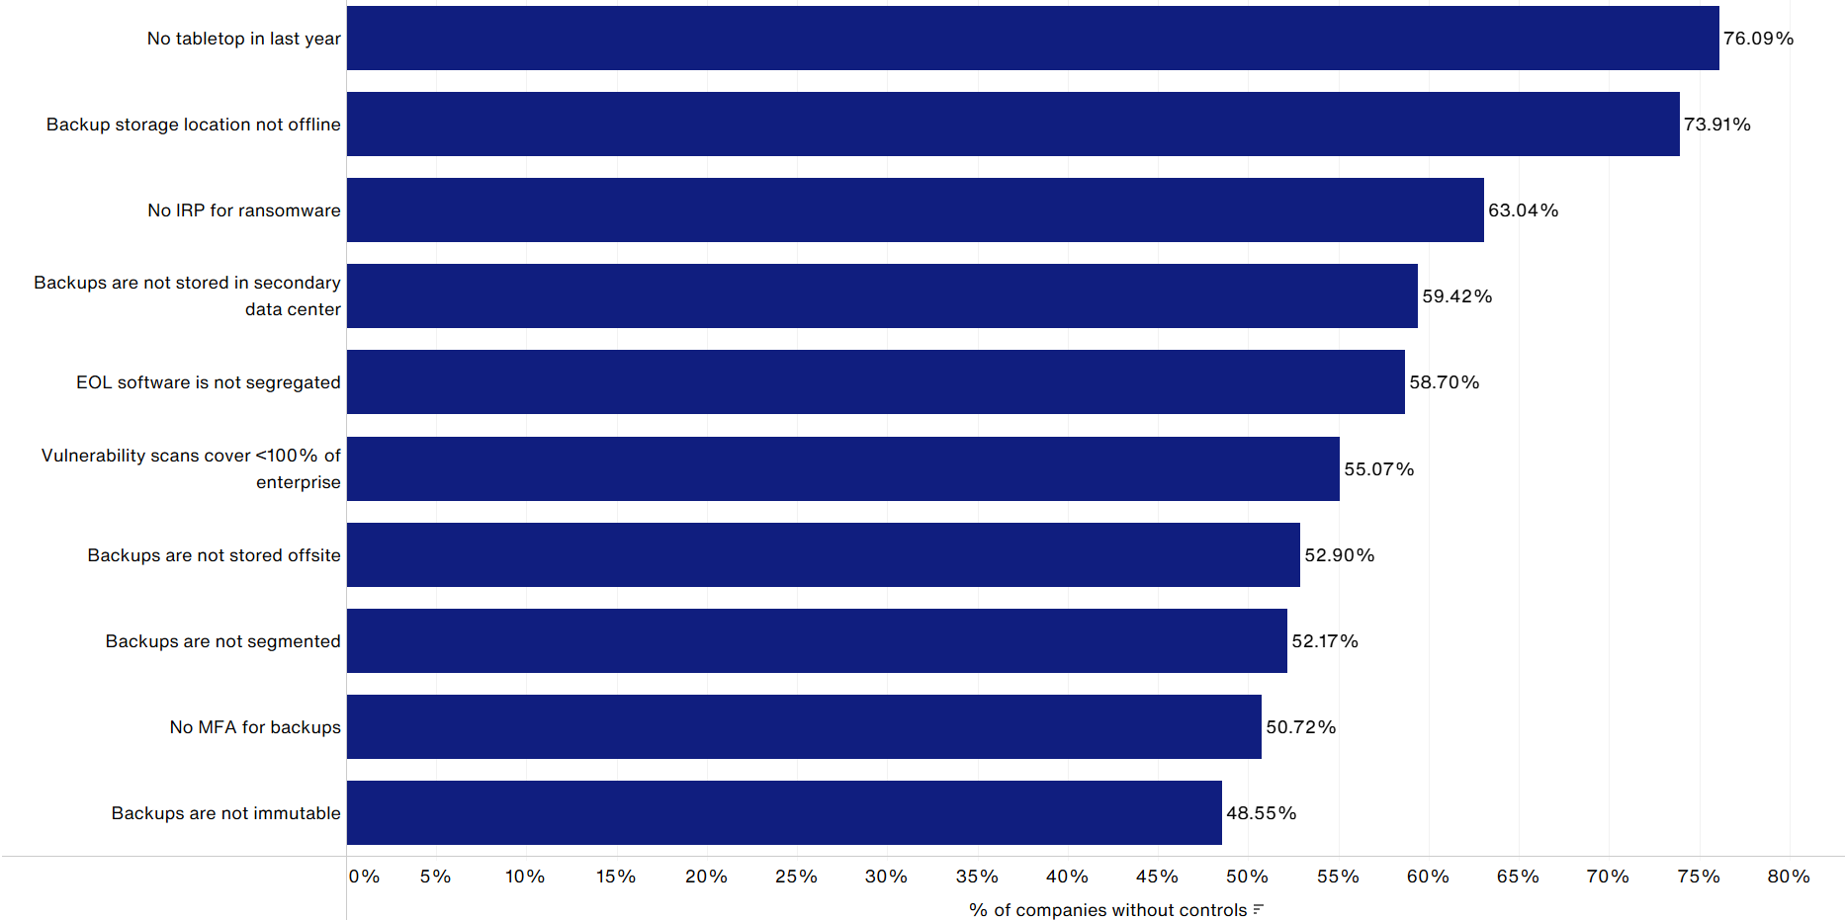
Top 10 Red Flags for Public Entities
Source: CyQu Red Flags data
Proprietary & Confidential: The content, analysis and commentary included herein constitute the proprietary and intellectual property data of Aon. Further distribution, photocopying or any form of third-party transmission of this document in part or in whole, is not permitted without the express, written permission of Aon. Copyright 2024. All rights reserved.
20
Notes:
Total red flags ~40. Not accounted for EDR{} red flag

Slide 21
2020–2024 Cyber Premium Changes by Quarter
Average Year–over–Year Change (Same Clients)
Proprietary & Confidential

Slide 22
Cyber Monthly Pricing All Layers
Average Year–over–Year Change (Same Clients)
Proprietary & Confidential

Slide 23
Retention and Limit Change Year Over Year
Retention Changes
Key Observations:
About 10% of our clients saw retention decreases in Q4. Relatively few clients experienced retention increases in Q4.​
    We continued to see ~20-25% of our clients purchase additional limits in Q4, with very few choosing to decrease limit.
Limit Changes
Proprietary & Confidential

Slide 24

Analytics and Risk Mitigation

Slide 25

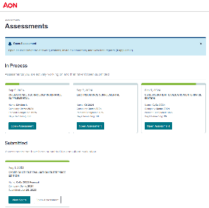
Better Informed Broking Process - CyQu
Enhance the broking process with CyQu
Easier Submissions and Stakeholder Collaboration
    Assess:
    Evaluate improvement opportunities and control maturity across nine critical domains.
    Analyze and Recommend:
    Flag and prioritize vulnerabilities that may impact insurability and help you triage gaps in critical controls
    Remediate and Mature:
    Prioritize security investments while optimizing risk costs. Collaborate with your account team on remediations to manage your exposure. Review with dedicated cyber broking consulting team.
    Attract Risk Transfer:
    A data-driven approach to managing security controls can help safeguard your balance sheet and better position you for insurability.
    Enable Cyber Resilience:
    Access services that will address the greater business impact of incidents. Align preparedness and prevention with response and remediation.
  CyQu, Aon’s patented¹ global cyber e-submission platform:
  Streamlines the submission process while identifying, measuring and managing a client’s risk exposure
  Includes multiple insurance application question sets to support cyber, E&O and miscellaneous professional liability insurance placements
  Is accepted by the majority of Aon’s largest insurance markets² and its insurance carrier panel
¹ United States Patent US 10,592,938 B2: System And Methods For Vulnerability Assessment And Provisioning Of Related Services And Products For Efficient Risk Suppression.
² The majority of largest cyber insurance markets, including Aon Structured Portfolio Solution for clients between $100M and $2B, accept CyQu as their main submission document. Aon Supplementals ransomware, errors and omissions, media content liability, operational technology, privacy and vendor are incorporated into and made part of any application for cyber coverage submitted by the applicant.

Slide 26
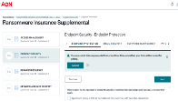



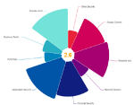

Better Informed
Drive Efficiencies with CyQu Portal
Streamline your insurance renewal, align stakeholders and utilize data insights to make better decisions and improve the submission process.
Achieving Cyber Resilience Every Day Using CyQu
Assess
Analyze and Recommend
Benefits of Using CyQu Portal over Traditional “Paper” Applications
    All-in-one interface offers a centralized location to complete and manage the insurance application process.
    Time-saving features, like the ability to pre-fill submission data for the subsequent year’s renewal, even when moving between assessment versions.
    Stakeholder alignment by providing a framework for risk management, finance, legal, and CISO/IT team members to better work together using the “collaborate” feature.
    Instant access to peer and industry benchmarks to provide insights.
    Visualize year-over year progress and track changes in cyber maturity using the compare assessment feature.
    Data-driven decisions with final summary report to measure and assess risk, and an insurability analysis powered by CyQu red flags and delivered through CyQu consulting.

Slide 27

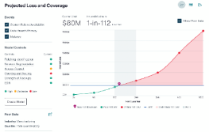
Better Informed Analytics – Cyber Risk Analyzer
Cyber Risk Analyzer helps clients take a strategic approach to cyber risk so they can help protect their balance sheets. It does more than just forecast expected loss — it empowers risk managers to better communicate the fundamental value that insurance provides to the C-suite, thereby promoting stakeholder alignment. .
Cyber Risk Analyzer offers the following key features
Loss Forecasting:
Model detailed loss scenarios faster, including privacy or data breach and system failure. The tool incorporates Aon’s customized proprietary simulation modelling approach based on internal claims insights, independent research by Aon’s Cyber Risk Consulting team, findings from bespoke cyber modelling engagements and third-party vendor data.
Security-Controls Exposure:
Assess security-controls risks to better determine a client’s loss output.
Total Cost of Risk (TCOR) Analysis:
Overlay loss forecasts with customized insurance options to produce a TCOR analysis.
Aon developed the Cyber Risk Analyzer to be a powerful digital platform which can simulate loss scenarios, contemplate security controls, and articulate total cost of risk (TCOR) in real time.

Slide 28

Claims Overview and
Reporting Roadmap

Slide 29

Public Entities By the Numbers
$4.88M
2024 Avg. Total Cost of Breach, up from $.45M in 2023 (Industrywide)
$2.55M
Cost of data breach for Public Entities
$5.74M
Avg. breach costs for organizations experiencing a high-level shortage of security skills
$1M
Cost savings when law enforcement is involved in ransomware attacks
292 Days
Days to identify and contain breaches involving stolen credentials
70%
Organizations that experienced significant or very significant disruption to business operations as a result of a breach.
Top 5 Cyber Threats for Public Entities
State Sponsored Cyberattacks | Ransomware | Phishing | Hacktivists | Improper Usage & Internal Attacks
    Government entities were in the top five industry classes targeted by both ransomware and business email compromise attacks in 2023, according to Artic Wolf. Additionally, the FBI reported that government entities was the third most targeted sector by ransomware in 2023.

Slide 30
Important Notice
Claims Made Policies
Claims Made Policies E&O/Cyber Liability policies often are claims made, which means that coverage applies to claims made during the policy period or extended reporting period (if applicable). | Reporting Requirements E&O/Cyber Liability policies generally require reporting of claims during the policy period in which they were made. Failure to do so can result in denial of coverage. | Insurer Approval E&O/Cyber Liability policies usually require the approval of the insurer(s) prior to selecting breach response vendors or defense counsel, incurring any defense costs, or agreeing to any settlement. Failure to do so can result in denial of coverage. | Note The above comments are general observations. Please refer to your policy for actual terms and conditions.
This is a summary and is not intended to be an exhaustive analysis of all coverage items, exclusions, terms or conditions relevant to all claims and exposure situations. Please refer to the actual policy(ies) for coverage items

Slide 31
Mandatory Vendors & Resources
Beazley BBR
Forensic Services
United States | Canada | Mexico
Stroz Friedberg, Aon Cyber Solutions | Stroz Friedberg Canada | KPMG
Ankura | Arctic Wolf Incident Response | Kroll
CRA – Charles River Associates | CRA | Mandiant
CrowdStrike | CrowdStrike | MaTTica
Kivu Consulting | CyberClan | Scitum
KPMG | KPMG
Kroll | Beazley Security
Mandiant | Mandiant
Artic Wolf | OKiOK
RSM | Palo Alto Networks, Unit 42
SecureWorks
Spear Tip
Sylint
Beazley Security
Booz Allen Hamilton
Legal Services
United States | Canada | Mexico
Baker Hostetler LLP | Dolden Wallace Follick | Calderon & De La Sierra
Constangy, Brooks & Prophete, LLP | Fasken Martineau DuMoulin | Davara Abogados
McDonald Hopkins LLC | Norton Rose Fulbright | Lex Informatica
Mullen Coughlin | Whitelaw Twining | R10S Abogados
Nelson Mullins
Octillo Law
Polsinelli PC
Shook, Hardy & Bacon L.L.P
Credit and Identity Monitoring
Geographically Agnostic
Equifax
Experian
Notification and Call Center Services
United States | Canada | Mexico
Dasher | Epiq | Business Advantage
Epiq Corporate Services | Equifax | Konecta
Experian | Miratel Solutions Inc. | Epiq Corporate Services
Intelligent Business Concepts
Kroll
Beazley panel vendor list as of January 1, 2025. For the most up to date list of providers and contact information, please click Here

Slide 32
Beazley Risk Management Offerings
 |  | For all cyber policyholders: | $30K+ premium: | $50K+ premium: | $100K+ premium:
Available throughout the policy period
Risk management portal |  | ✓ | ✓ | ✓ | ✓
Employee training |  | ✓ | ✓ | ✓ | ✓
Vendor discounts |  | ✓ | ✓ | ✓ | ✓
Risk management webinars |  | ✓ | ✓ | ✓ | ✓
Onboarding video |  | ✓ | ✓ | ✓ | ✓
Secure, out-of-band incident response preparation room |  | ✓ | ✓ | ✓ | ✓
Onboarding call with Cyber Services* |  | ✓ | ✓ | ✓ | ✓
Incident Response Plan (IRP) review* |  | ✓ | ✓ | ✓ | ✓
One risk management offering per policy year
M365 cybersecurity assessment |  |  | ✓ | ✓ | ✓
Ransomware and BEC best practices workshop |  |  | ✓ | ✓ | ✓
IT rationalization assessment |  |  | ✓ | ✓ | ✓
Crisis communications workshop |  |  | ✓ | ✓ | ✓
Crafting an IRP workshop |  |  | ✓ | ✓ | ✓
Phishing-resistant MFA keys |  |  | Up to 30 keys | Up to 60 keys | Up to 100 keys
One-year phishing campaign assessment | Managed by insured |  | Up to 200 users | Up to 1000 users | Up to 2000 users
One-year phishing campaign assessment (vendor-managed) | Vendor-managed |  |  | Up to 500 users | Up to 1000 users
Board of directors presentation on data security |  |  |  | ✓ | ✓
IR workshop with tabletop |  |  |  | 2 hour virtual | 4 hour onsite
Information security best practices session |  |  |  | 2 hour virtual | 2 hour virtual
Business continuity planning workshop |  |  |  | 2 hour virtual | 4 hour onsite
Ransomware readiness assessment |  |  |  |  | ✓
C-suite/Board training on cyber resiliency |  |  |  |  | ✓
*denotes clients $35M+ in annual revenue
Beazley policyholder complimentary services as of January 22, 2025. For the most up to date list of services and contact information, please click Here

Slide 33
Claims Reporting Roadmap
Beazley
You are here: Your firm has suffered a security incident. The clock is now ticking. It’s time to do right by your customers, employees, shareholders and others. A quick, effective response will help you to avoid lawsuits and regulatory inquiries.
A Beazley Claims Specialist will assist with identifying the resources needed to respond to the event and will provide consent as required.
1
Engage a pre–approved computer forensics firm to determine existence, cause and scope of the breach.
2
Engage ransomware response vendor if necessary.
3
Determine if a public relations or crisis communication firm is required.
Debrief with Beazley Cyber Claims.
Some important things to cover:
When and how discovered
Type of event
Who attacked
Extent of attack
Impact on business
Type of data at risk
# and location of people potentially impacted
Ransom demand and threat actor
Immediately gather your internal team and review your incident response plan.
4
Consult with experts to determine if notifications are necessary. If so, decide who needs to be notified and utilize a pre–approved vendor.
5
After assessing the notification requirements, determine if a call center is required and contact a pre–approved vendor.
Call the Beazley Breach Hotline at 866–567–8570; then contact the pre–approved expert privacy attorneys to determine legal applicability of actions, to respond to reporting requirements, and to maintain privilege. These lines are monitored seven (7) days a week. Leave a voicemail message. Contact your Aon broker to provide formal notice to Beazley.
6
Decide if credit or identity monitoring is necessary. If so, contact the proper credit and identity monitoring firm.
7
Consider engaging forensic accountant; set up method to track and document cyber–related expenses.
Consult with your expert privacy attorney on the current situation and begin to determine what next steps are necessary.
Execute your Response Plan.
Please note that the above flowchart is intended to serve as a high–level guide throughout the claims management process. Please refer to your policy(ies) for more affirmative guidelines regarding claims reporting and the applicability of coverage for said incident. By no means does the above flowchart represent or guarantee the applicability of coverage for each event; coverage determinations are subject to the policy terms and conditions.

Slide 34
Ransomware Claims
Case Studies
Case Study #1: Ransomware Payment
Client Situation | Our client experienced a multiple-day shutdown following a severe ransomware attack. The client provided business-critical services through its public-facing website, which was subject to the shutdown. Forced to swiftly mitigate further loss, the client paid an estimated $8 million as a cyber extortion payment. Aon repeatedly engaged the cyber insurer on the client’s behalf as the client negotiated and determined the need to pay the ransom.
Aon Approach | After the client made payment, the insurer was vocal in reserving the right to deny extortion coverage, on grounds such as reasonableness and adequacy of the client’s attested cybersecurity measures. The insurer submitted over 30 questions in its investigation. Aon emphasized the client’s demonstrated case for reasonableness and curbed the insurer’s scrutiny on cybersecurity, significantly reducing the number of questions to 5. Further, Aon ensured direct engagement by the decision makers at the insurer, who had previously been primarily relying on its outside coverage counsel.
Aon Client Value & Impact | The cyber insurer timely reimbursed the ransom as well as related incident response/breach costs, a policy limit recovery of $10 million. Additionally, Aon assisted the client with its kidnap and ransom policy, which included cyber extortion coverage. Aon resolved the insurer’s hesitation on the client’s non-disclosure requirements and facilitated recovery of the full responsive K&R limit of $2 million.
Case Study #2: Extra Expense
Client Situation | Our client located an advanced persistent threat on its systems. The threat was a form of ransomware, although it did not mature to point of decryption. This strain of malware is extremely sophisticated, embeds itself deep within the systems, and is difficult to eradicate. Three of the client’s locations were impacted, and instances of reinfection occurred through the remediation process. To restore services and to keep malware from infecting end point devices and data, the client replaced its entire network system. The total loss was $2.8M.
Aon Approach | The insurer denied most of the loss stating this was not a ransom attack impacting data and the replacement of the system was not reasonable and necessary as this was betterment and not covered under the policy. As a threshold issue, Aon convinced the insurer that the policy did not require a ransomware event to trigger data recovery costs, as the coverage was triggered by the security event and efforts were made to restore data infected by the malware. Aon then collaborated with the client in putting together a justification for the expenses, including support that other efforts would have cost more money.
Aon Client Value & Impact | The client’s position was a tough one as insurers do not fund typically fund a new system and point to reasons other than the event that support the need for the replacement. Thus, the insurer’s initial response was to have a forensic review of the incident, but the client did not want to extend the dispute and potentially risk further support for the insurer’s denial. Aon persuaded the insurer to negotiate based on the information provided, which ultimately led to the insurer agreeing to recognize $1.2M of the loss, much to the client’s satisfaction.

Slide 35
Crowdstrike
Incident Summary & Impact
On July 19, 2024, Crowdstrike released a faulty update to its Falcon sensor that caused Windows computers to crash Falcon is a widely used EDR tool Microsoft estimated that 8.5 million, less than 1% of all Windows devices were impacted Reportedly the largest IT outage in history Crowdstrike released a fix in under 80 minutes, but it required devices to be manually booted into Safe Mode By July 29, 99% of Windows sensors were back online Full scope of incident still unknown Crowdstrike reported that while it has not experienced “high levels of customer churn,” it has adversely affected sales The error was not caused by malicious activity
Event Implications
Financial | Legal | Insurance
Through Q3, CrowdStrike reported that incident-related costs were over $39 million Shares fell from $343.05 on July 18, to a low of $217.89 on Aug. 2, but have since recovered In its Q3 financials, CrowdStrike reported that it has offered “customer commitment packages” to certain customers, which may include extended subscription periods, discounts, additional modules, professional services, and/or flexible payment terms. | A shareholder class action and consumer class actions have been filed against Crowdstrike Customers have sought indemnity from and/or sued Crowdstrike (Delta claims $500+ million in losses) Crowdstrike has reported that it received inquiries from regulators concerning the outage | CrowdStrike reports it has insurance to cover losses related to the outage, but anticipates that its coverage will not cover all costs and liabilities actually incurred Of the Aon clients that were impacted by the July 19th outage, approximately less than 10% are pursuing coverage for losses in excess of their respective retentions
Proprietary & Confidential

Slide 36
Public Entity Ransomware Cases
City, State | Demand (USD) | Recovery (USD) | Description of Event
City of Hayward, California | Not publicly disclosed | Not publicly disclosed | July 2023, the City of Hayward suffered a ransomware attack, early response did not indicate any signs of data extraction or data breach. City officials closed access to its public website and online portals
City of Oakland, California | Not Paid | Not publicly disclosed - Expected in excess of $3M | February 2023, the City of Oakland was impacted by PLAY ransomware, 610 GB of data leaked on dark web including SSN, home addresses, and medical data from thousands of current and former city employees and confidential information from residents that have filed claims against the city or applied for programs through city websites, city administrator declared state of emergency to fast-track response. Residents reported being unable to access online sites to make payments. Although calls to 911 were working, response times were delayed due to dispatching outages.
San Bernardino County, California | $1.1M | $1.9M | Early 2023, the County of San Bernardino was impacted by PLAY ransomware, over a period of one month, over $1.1M was paid to a reported Russian-linked group that infiltrated and shut down computer systems, the county paid $511,852 of the $1.1M, the remainder being paid by insurance, policy included a 50% coinsurance for ransomware related losses. Sherriff’s Department was forced to shut down systems such as email, in-car computers, and some law enforcement databases, including systems used by deputies for background checks.
Clay County, Indiana | Not publicly disclosed | Not publicly disclosed | July 2024, Clay County suffered a ransomware attack that resulted in an inability to provide critical services. This attack affected all offices of the Clay County Courthouse, Community Corrections, and Clay County Probation. Local and federal law enforcement agencies were contacted. The local government declared a "local disaster emergency" that lasted for a week.
Los Angeles County, California | Not publicly disclosed | Not publicly disclosed | July 2024, The Superior Court of Los Angeles County was hit by a ransomware attack. The attack disrupted many critical systems and forced the court to shut down nearly all network systems in order to contain the damage. This resulted in 36 closed courthouses to work on recovery. The Judicial Council of California permitted the Superior Court to extend deadlines to help mitigate damages.
Washington County, Pennsylvania | Not publicly disclosed | $350,000 | January 2024, Washington County experienced a ransomware attack by foreign cybercriminals. The attack seized control of the county's network and froze many of the county's operations. Hackers pilfered a large amount of sensitive information, including information about children in the court system. The county chose to pay the demand approximately two weeks after the attack.
Bernalillo County, New Mexico | Not publicly disclosed | Not publicly disclosed | In January 2022, a ransomware attack impacted the county’s jail, inmates were confined to their cells due to the facility’s surveillance cameras and data-collection capabilities. Court documents stated the ransomware attack led to the jail’s automated doors deactivating – requiring personnel to use manual keys.
City of Chicago’s Department of Aviation | Not publicly disclosed | Not publicly disclosed | An employee of the City of Chicago’s Department of Aviation received an email from a provider of custodial services at Midway and O’Hare airports requesting an electronic payment of $1,150,759.82. The employee followed the instructions, it was discovered a few weeks later that the email account was compromised, and funds were recovered.

Slide 37
About Aon
Aon exists to shape decisions for the better — to protect and enrich the lives of people around the world. Through actionable analytic insight, globally integrated Risk Capital and Human Capital expertise, and locally relevant solutions, our colleagues provide clients in over 120 countries and sovereignties with the clarity and confidence to make better risk and people decisions that help protect and grow their businesses.
Follow Aon on LinkedIn, X, Facebook and Instagram. Stay up-to-date by visiting Aon's newsroom and sign up for news alerts here.
© 2025 Aon plc. All rights reserved.
Insurance products and services offered by Aon Risk Insurance Services West, Inc., Aon Risk Services Central, Inc., Aon Risk Services Northeast, Inc., Aon Risk Services Southwest, Inc., and Aon Risk Services, Inc. of Florida and their licensed affiliates. All descriptions, summaries or highlights of coverage are for general informational purposes only and do not amend, alter or modify the actual terms or conditions of any insurance policy. Coverage is governed only by the terms and conditions of the relevant policy. Aon does not provide legal advice. The information provided is based solely on Aon’s experience as insurance practitioners. We recommend that you consult with your own legal advisors.
About Cyber Solutions:
Cyber security services are offered by Stroz Friedberg Inc., its subsidiaries and affiliates. Stroz Friedberg is part of Aon’s Cyber Solutions which offers holistic cyber risk management, unsurpassed investigative skills, and proprietary technologies to help clients uncover and quantify cyber risks, protect critical assets, and recover from cyber incidents.

Slide 38

Third Party Hosted Cyber Liability Insurance
  Jonathan Smith
  Director, Risk Management
  jonathan.m.smith@vita.virginia.gov

Slide 39
FAQ
Cyber Liability Insurance
  What is cyber liability insurance?
    Insurance policy to cover organizations when they experience cyber security incidents that affect privacy, data, and network exposures and the costs associated with containment, investigation, eradication and reconstitution of application(s)/service(s) as well as costs associated with credit monitoring.
    A method to transfer risk to other organizations
What is the appropriate amount of cyber liability insurance?
    VITA has set a default amount of cyber liability insurance at $5 million per occurrence.
    Agencies should ensure that the appropriate amount of cyber liability insurance is required of the supplier.

Slide 40
How to estimate the amount of Cyber Liability insurance is needed
Cyber Liability Insurance
  What do we need to estimate the amount of cyber liability insurance?
  A description of the application/service and the business processes that it will support.
  Will the application/service process and/or store sensitive data with relation to confidentiality, integrity, and/or availability?
    If yes, please describe the sensitive data (i.e. confidentiality - PII, PHI , integrity - financial records , availability - public safety data).
  Approximately how many records will the application/service process and store?
  Approximately how many (max) unique individuals may be impacted in the event of a cyber security event?

Slide 41
Cyber liability insurance calculation
Cyber Liability Insurance
  Cyber liability insurance calculation
  CSRM developed a methodology to estimate costs associated with the detection, response, and recovery activities associated with cyber security incidents.
  Based on industry trends and Commonwealth costs
  Formula based on a decaying ‘line of best fit’

Slide 42
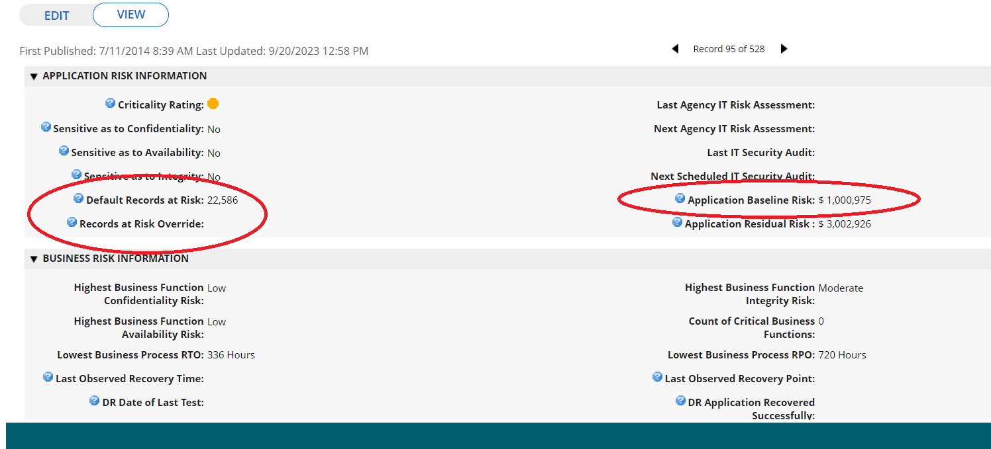
Archer visual
Cyber Liability Insurance
  Cyber liability insurance calculation – Archer eGRC

Slide 43

Questions
Questions?
  Jonathan Smith
  Director, Risk Management
  jonathan.m.smith@vita.virginia.gov

Slide 44
TLS 1.0/1.1 Remediation
Enterprise Project
John Del Grosso, SSDC Service Owner
Notes:
No image title slide - Any text that looks black is HEX code 414042.

Slide 45
Encryption protocols have gone end-of-life
Release | Release date | End of life
TLS 1.3 | March 2018
TLS 1.2 | August 2008
TLS 1.1 | April 2006 | June 30, 2018
TLS 1.0 | January 1999 | June 30, 2018
Transport layer security (TLS) 1.0 and TLS1.1 are end-of-life
There were several extensions due to COVID and other industry-related delays
All TLSv1.0 and v1.1 must migrate to TLSv1.2 or TLSv1.3

Slide 46
Deprecation of TLSv1.0/v1.1
Nearly every agency has some in-motion data that is using either TLSv1.0 and/or v1.1 within the data centers in the COV and going outside the COV.
Process to identify sources:
The Unisys and multi-sourcing service integrator (MSI) teams have used Atos ‘Tenable’ data and other sources to identify the servers, ports and TLS versions that have been detected as using v1.0 and v1.1.
Next steps:
The next step is for the team to determine the best and least intrusive method to limit all server ports to only using TLSv1.2. Those will incorporate direct means (specific to a server) or global means. The team will work directly with each agency for complete collaboration.
To ensure operations are not negatively impacted, no changes will be made globally.
vita.virginia.gov
Notes:
This slide background works best with text heavy sections, with no imagery is used OR when an Icon is used

Slide 47
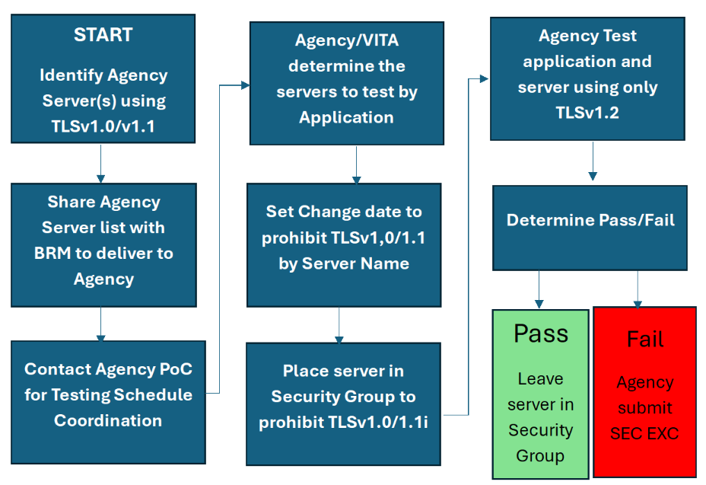
Process diagram
vita.virginia.gov
Notes:
This slide background works best with text heavy sections, with no imagery is used OR when an Icon is used

Slide 48
How agencies can help get ahead of the end-of-life deprecation
Determine if your agency-owned application(s) support use of v1.2
Check the operating system (OS) settings. If the OS security settings on a server have been changed to allow ‘any’ TLSv1.x, to change those switches back to TLSv1.2+ only
If agency applications cannot support TLS1.2+, then submit a security exception(s) in Archer to identify the server name and agency application, along with the remediation actions required.

Slide 49
Questions?
Notes:
This slide is used as a transition title slide for a new section

Slide 50

Announcements
ISOAG March 5, 2025
Notes:
Example of when to use this slide background for a call out section and text

Slide 51

Nucleus User Guides Are Here!
Hey ISOs! The Nucleus User Guides are now live on the CSRM Connections website!
Learn how to:
✅Access & analyze vulnerabilities
✅Prioritize risks effectively
✅Streamline workflows & boost security
View the guides today on CSRM Connections (Under the “ISO Resources” link on the right side)
Strengthen your agency’s security with ease! 🔐

Slide 52

SPLUNK UPDATE – 🌈Strike Gold with Your Splunk Logs!🍀
Just like finding a pot of gold at the end of the rainbow, now is the perfect time to identify the logs you want ingested into the VITA Splunk instance! VITA is partnering with agencies to bring your application logs into Splunk, helping you uncover valuable insights and strengthen security. Don’t let your logs stay hidden like leprechaun treasure—let us know which logs you need ingested. We're always happy to schedule a call to discuss your options and ensure everything is ready to go. Let’s make sure your logs shine like a lucky four-leaf clover this year! 🍀
Notes:
Example of when to use this slide background for a call out section and text

Slide 53


Top 5 Vulnerabilities
For the Month of March, the Top 5 Key Vulnerabilities are:
KB5044343 Windows Server 2012 R2 Security Update (October 2024)
KB5043138: Windows Server 2012 R2 Security Update (September 2024)
Oracle Java SE Multiple Vulnerabilities (October 2018 CPU) (Unix)
Microsoft .NET Core SEoL
IBM Java 6.0 < 6.0.16.75 / 6.1 < 6.1.8.75 / 7.0 < 7.0.10.35 / 7.1 < 7.1.4.35 / 8.0 < 8.0.5.25 Multiple Vulnerabilities
vita.virginia.gov
Notes:
This slide background works best with text heavy sections, with no imagery OR when an Icon is used

Slide 54

FYSA
Staff Changes
  Chris Williams is the Director of Enterprise and Security Architecture.
Notes:
This slide works best with photos and graphs/charts. Image and text can be reversed

Slide 55
Upcoming Events
vita.virginia.gov
Notes:
This slide is used as a transition title slide for a new section

Slide 56

Service Tower SOC Report Review Sessions
      To register for this meeting, please click on the link below:
      https://covaconf.webex.com/weblink/register/re1ad0ac90a496f42b7a8bcb25d01f763
The upcoming SOC review session is March 11, 2025, and will be held remotely.
Please register at the link below
Notes:
Example of when to use this slide background for a call out section and text

Slide 57

IS Orientation
The next IS Orientation is being held in March
  March 26, 2025, from 9am to 4pm, registration closes March 19th.
  It will be held in-person at the Boulders location:
  7325 Beaufont Springs Drive, Richmond, VA 23225
  Visit Commonwealth IS Orientation to register!
Notes:
This slide works best with photos and graphs/charts. Image and text can be reversed

Slide 58


Government Cybersecurity Showcase Virginia
Elevating Virginia’s Digital Defense
Public Sector Network is presenting: Government Cybersecurity Showcase Virginia
Held on Wednesday, April 9, 2025, at the Downtown Richmond Marriott
  The registration link is below:
    Public Sector Network » Event - Government Cybersecurity Showcase Virginia
Notes:
This slide works best with photos and graphs/charts. Image and text can be reversed

Slide 59

Commonwealth of Virginia Information Security Conference 2025
Commonwealth of Virginia Information Security Conference 2025
Future-Proofing Cybersecurity:
Next-Gen Strategies
August 14, 2025
Hilton Richmond Hotel, 12042 West
Broad St., Richmond, VA 23233
Registration will open soon!
Notes:
This slide works best with photos and graphs/charts. Image and text can be reversed

Slide 60
MEETING ADJOURNED
Notes:
Title slide - Any text that looks black is HEX code 414042. If you have an idea for an image, let me know and I can provide you with one.

